Slide 1
ECEN 150 Circuit Analysis I
Phasors and Impedance

Slide 2
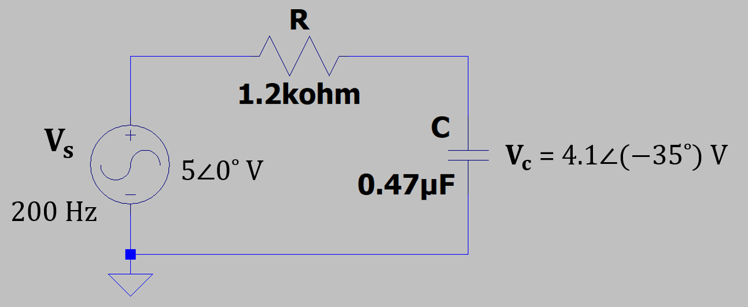
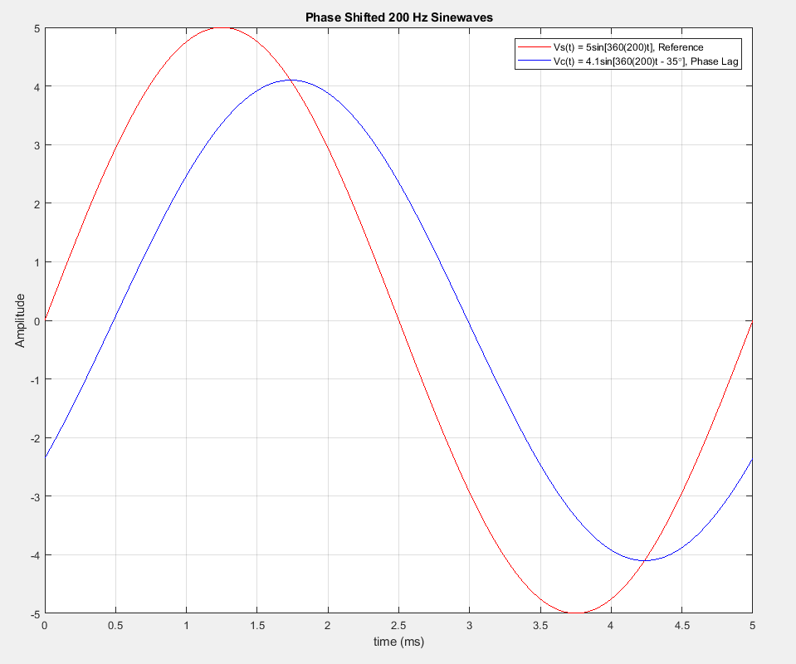
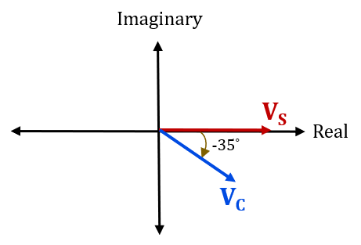
AC Steady-State and Phasors
For AC steady-state at a given frequency, the
amplitude and phase angle difference between V_{s}
and V_{c} is a constant in the above circuit.
A complex number, referred to as a phasor,
is used to denote this constant peak amplitude
(magnitude) and phase angle difference between
V_{s} and V_{c} at the given frequency.
Phasors are not a function of time, since for
steady-state the constant peak amplitude (magnitude)
and phase angle difference between V_{s} and V_{c} is not a function of time.
Need Euler’s formula to arrive at a mathematical expression for phasors.

Slide 3
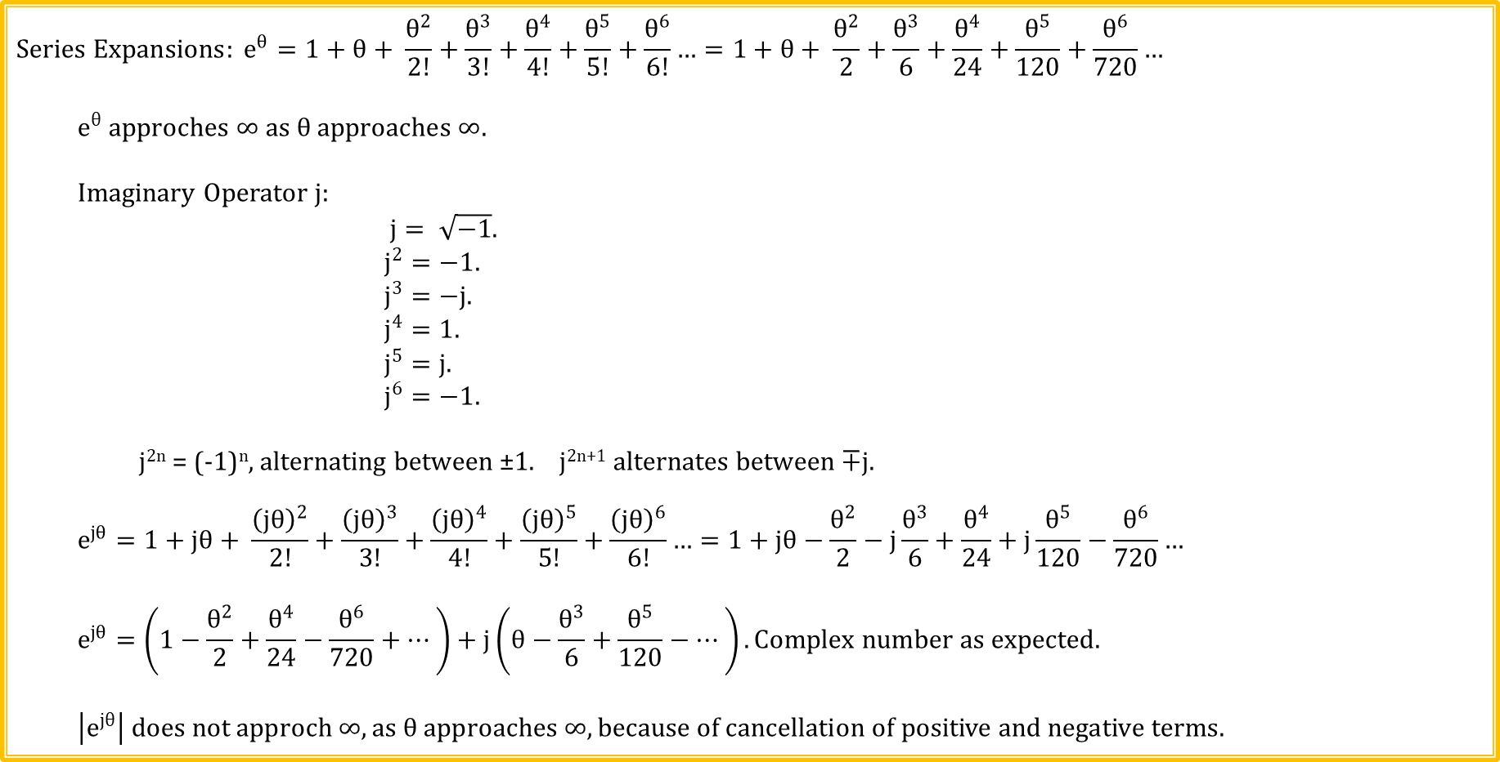
Series Expansion for e^{θ}
$$Series Expansions: e^{θ}=1+θ+ \frac{θ^{2}}{2!}+\frac{θ^{3}}{3!}+\frac{θ^{4}}{4!}+\frac{θ^{5}}{5!}+\frac{θ^{6}}{6!}…=1+θ+ \frac{θ^{2}}{2}+\frac{θ^{3}}{6}+\frac{θ^{4}}{24}+\frac{θ^{5}}{120}+\frac{θ^{6}}{720}…$$
$$e^{θ} approches ∞ as θ approaches ∞.$$
Imaginary Operator j:
$j= \sqrt{−1}.$
$j^{2}=−1.$
$j^{3}=−j.$
$j^{4}=1.$
$j^{5}=j.$
$j^{6}=−1.$
j^{2n} = (-1)^{n}, alternating between ±1. j^{2n+1} alternates between ∓j.
$$e^{jθ}=1+jθ+ \frac{{\left(jθ\right)}^{2}}{2!}+\frac{{\left(jθ\right)}^{3}}{3!}+\frac{{\left(jθ\right)}^{4}}{4!}+\frac{{\left(jθ\right)}^{5}}{5!}+\frac{{\left(jθ\right)}^{6}}{6!}…=1+jθ−\frac{θ^{2}}{2}−j\frac{θ^{3}}{6}+\frac{θ^{4}}{24}+j\frac{θ^{5}}{120}−\frac{θ^{6}}{720}…$$
$$e^{jθ}=\left(1−\frac{θ^{2}}{2}+\frac{θ^{4}}{24}−\frac{θ^{6}}{720}+…\right)+j\left(θ−\frac{θ^{3}}{6}+\frac{θ^{5}}{120}−…\right). Complex number as expected.$$
$$\left|e^{jθ}\right| does not approch ∞, as θ approaches ∞, because of cancellation of positive and negative terms.$$

Slide 4
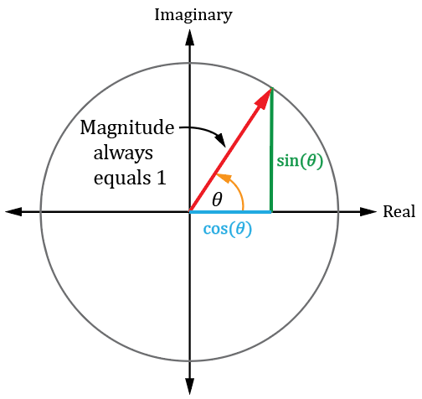
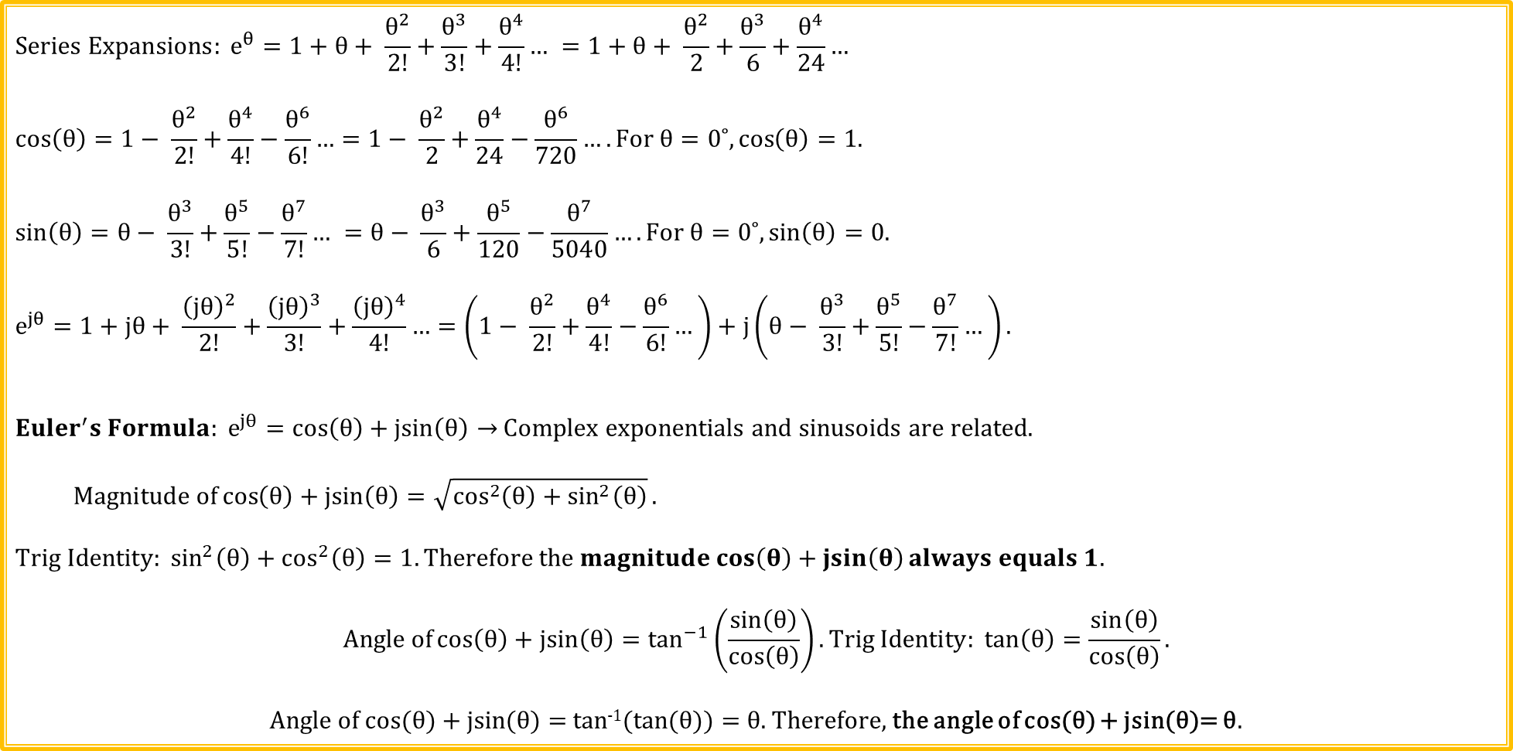
Euler’s Formula
$$Series Expansions: e^{θ}=1+θ+ \frac{θ^{2}}{2!}+\frac{θ^{3}}{3!}+\frac{θ^{4}}{4!}… =1+θ+ \frac{θ^{2}}{2}+\frac{θ^{3}}{6}+\frac{θ^{4}}{24}…$$
$$\cos\left(θ\right)=1− \frac{θ^{2}}{2!}+\frac{θ^{4}}{4!}−\frac{θ^{6}}{6!}…=1− \frac{θ^{2}}{2}+\frac{θ^{4}}{24}−\frac{θ^{6}}{720}….For θ=0˚,\cos\left(θ\right)=1.$$
$$\sin\left(θ\right)=θ− \frac{θ^{3}}{3!}+\frac{θ^{5}}{5!}−\frac{θ^{7}}{7!}… =θ− \frac{θ^{3}}{6}+\frac{θ^{5}}{120}−\frac{θ^{7}}{5040}…. For θ=0˚,\sin\left(θ\right)=0.$$
$$e^{jθ}=1+jθ+ \frac{{\left(jθ\right)}^{2}}{2!}+\frac{{\left(jθ\right)}^{3}}{3!}+\frac{{\left(jθ\right)}^{4}}{4!}…=\left(1− \frac{θ^{2}}{2!}+\frac{θ^{4}}{4!}−\frac{θ^{6}}{6!}…\right)+j\left(θ− \frac{θ^{3}}{3!}+\frac{θ^{5}}{5!}−\frac{θ^{7}}{7!}…\right).$$
${{Euler}^{′}s Formula: e}^{jθ}=\cos\left(θ\right)+\operatorname{jsin}\left(θ\right)→$ Complex exponentials and sinusoids are related.
$$Magnitude of\cos\left(θ\right)+\operatorname{jsin}\left(θ\right)=\sqrt{\cos^{2}\left(θ\right)+\sin^{2}\left(θ\right)}.$$
$$Trig Identity: \sin^{2}\left(θ\right)+\cos^{2}\left(θ\right)=1. Therefore the magnitude\cos\left(θ\right)+\operatorname{jsin}\left(θ\right)always equals 1.$$
$$Angle of\cos\left(θ\right)+\operatorname{jsin}\left(θ\right)=\tan^{−1}\left(\frac{\sin\left(θ\right)}{\cos\left(θ\right)}\right). Trig Identity: \tan\left(θ\right)=\frac{\sin\left(θ\right)}{\cos\left(θ\right)}.$$
Angle of cos(θ) + jsin(θ) = tan⁻¹(tan(θ)) = θ. Therefore, the angle of cos(θ) + jsin(θ)= θ.

Slide 5
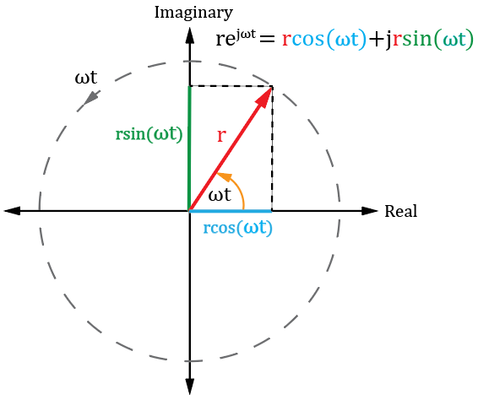
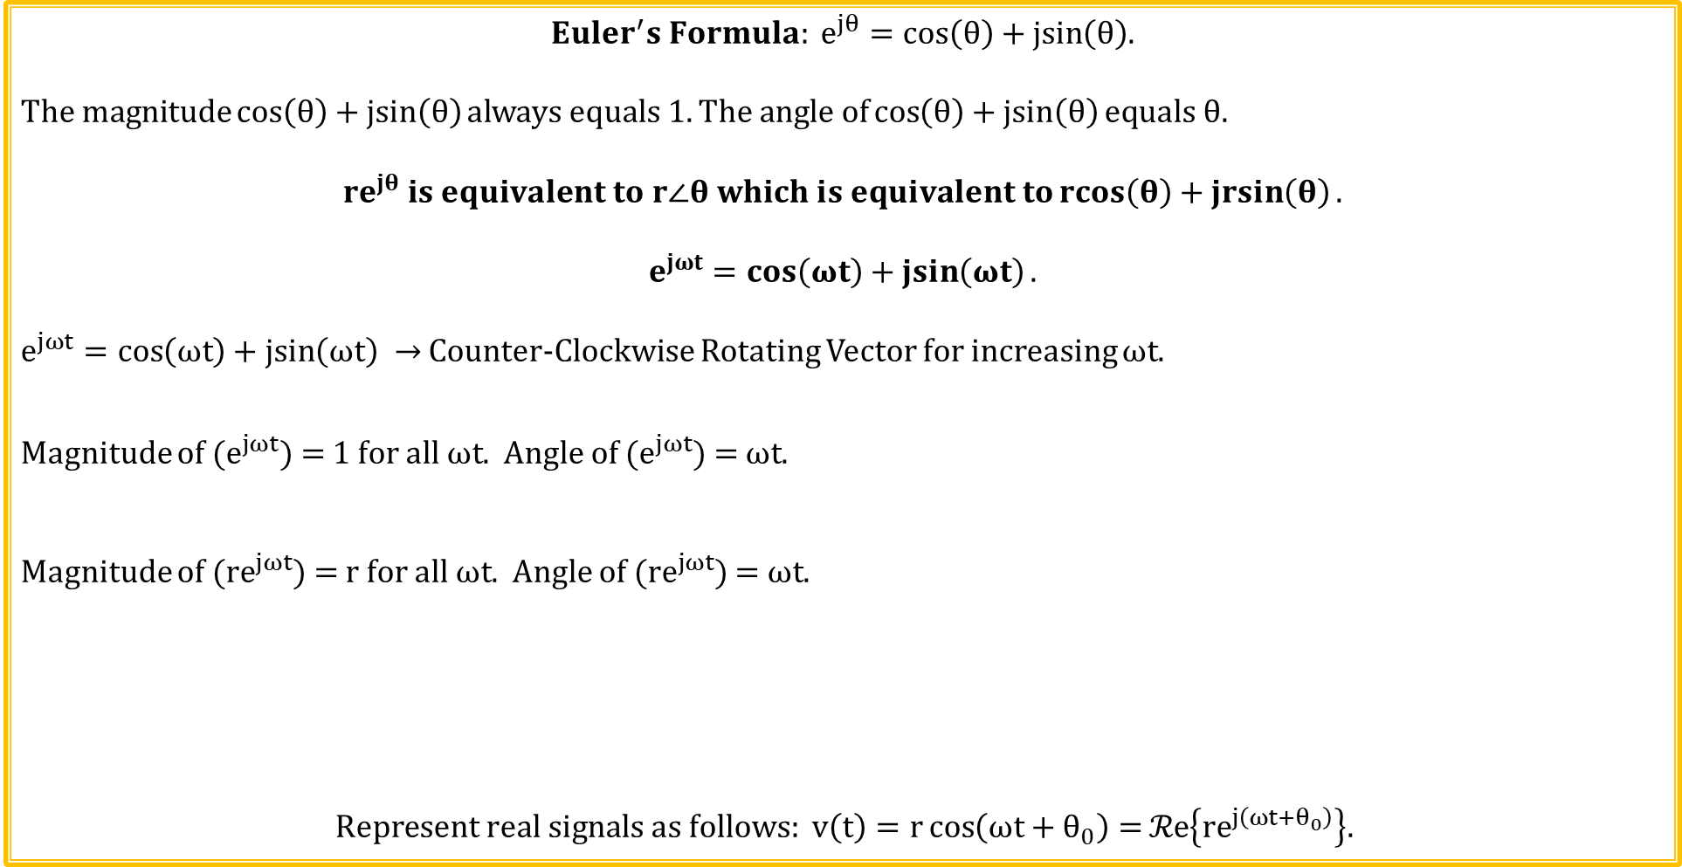
Euler’s Formula and Signal Representation
${{Euler}^{′}s Formula: e}^{jθ}=\cos\left(θ\right)+\operatorname{jsin}\left(θ\right)$.
$$The magnitude\cos\left(θ\right)+\operatorname{jsin}\left(θ\right)always equals 1.The angle of\cos\left(θ\right)+\operatorname{jsin}\left(θ\right)equals θ.$$
$${re}^{jθ} is equivalent to r∠θ which is equivalent to\operatorname{rcos}\left(θ\right)+\operatorname{jrsin}\left(θ\right).$$
$$e^{jωt}=\cos\left(ωt\right)+\operatorname{jsin}\left(ωt\right).$$
$e^{jωt}=\cos\left(ωt\right)+\operatorname{jsin}\left(ωt\right) →$ Counter-Clockwise Rotating Vector for increasing $ωt$.
Magnitude of ($e^{jωt}$) = 1 for all $ωt$. Angle of ($e^{jωt}$) = $ωt$.
Magnitude of (${re}^{jωt}$) = r for all $ωt$. Angle of (${re}^{jωt}$) = $ωt$.
$$Represent real signals as follows: v\left(t\right)=r\cos\left(ωt+θ_{0}\right)=ℛe\left\{{re}^{j\left(ωt+θ_{0}\right)}\right\}.$$
Rotating Phasor Animation

Slide 6
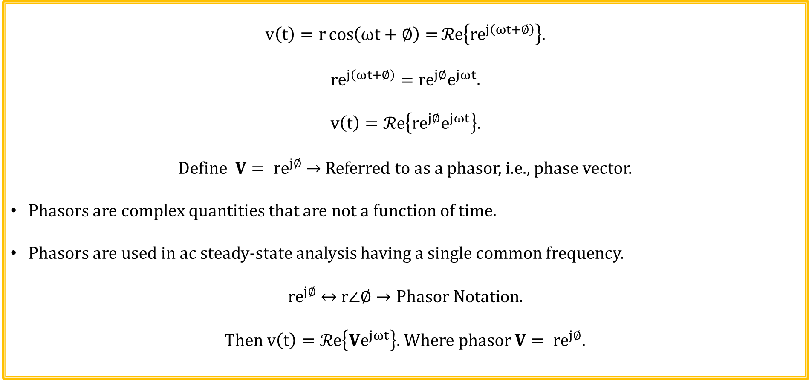
Phasor Signal Representation
$$v\left(t\right)=r\cos\left(ωt+∅\right)=ℛe\left\{{re}^{j\left(ωt+∅\right)}\right\}.$$
$${re}^{j\left(ωt+∅\right)}={re}^{j∅}e^{jωt}.$$
$$v\left(t\right)=ℛe\left\{{re}^{j∅}e^{jωt}\right\}.$$
$Define V= {re}^{j∅}$ $→$ Referred to as a phasor, i.e., phase vector.
Phasors are complex quantities that are not a function of time.
Phasors are used in ac steady-state analysis having a single common frequency.
${re}^{j∅}$ ↔ $r∠∅→Phasor Notation.$
$Then v\left(t\right)=ℛe\left\{{Ve}^{jωt}\right\}.$ Where phasor $V= {re}^{j∅}$.

Slide 7
Phasor – (Phase Vector)
Phasor – amplitude and phase of a given
sinusoidal waveform.
Different spelling that Star Trek Phaser.
Phasors referred to as Sinors by some authors,
although the term sinor is considered outdated.
Phasor is a complex number representing
magnitude (amplitude) and phase of a cosine
waveform with respect to a reference cosine
waveform.
Can add, subtract, multiply and divide phasors
when they are all of the same frequency.
Assign an angle of zero to a reference cosine waveform, which is usually the AC power source of the circuit.
Ohm’s law applies for AC circuits with L’s and C’s if phasors are used to keep track of phase differences.
Imaginary
Leading phase angle corresponds to time advance.
Leading phase angle
Real
Lagging phase angle
Lagging phase angle corresponds to time delay.

Slide 8
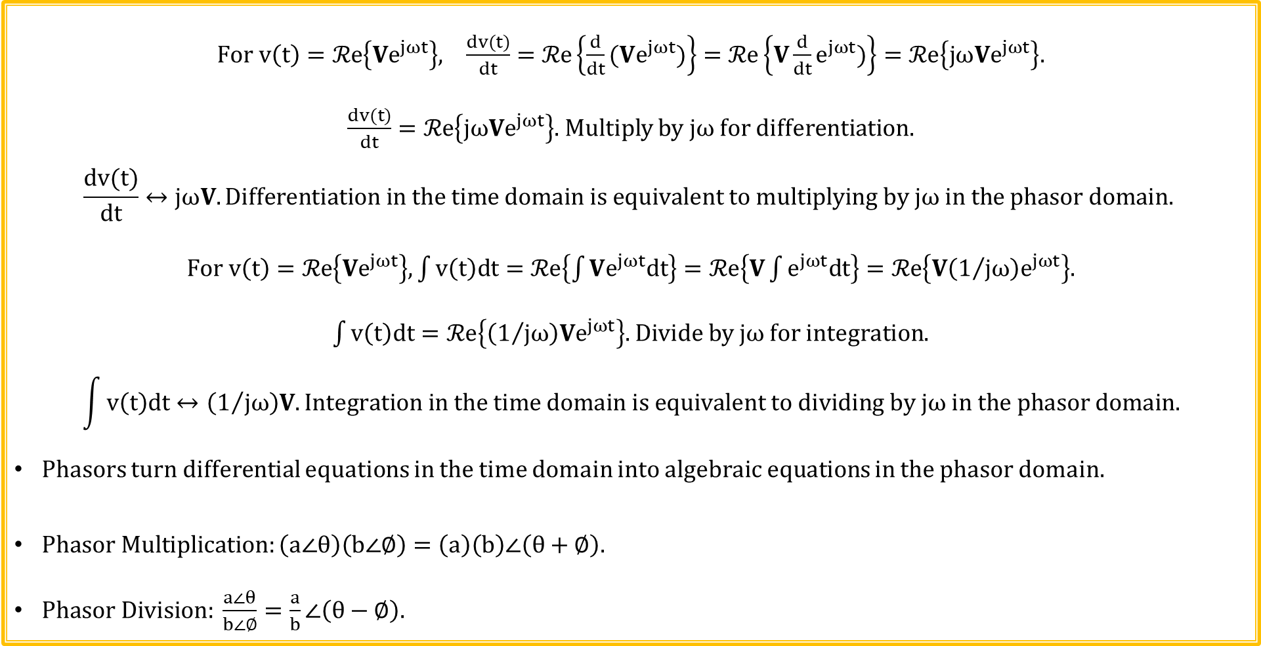
Phasor Relationships
$For v\left(t\right)=ℛe\left\{{Ve}^{jωt}\right\}, \frac{dv(t)}{dt}=ℛe\left\{{\frac{d}{dt}(Ve}^{jωt})\right\}=ℛe\left\{{V\frac{d}{dt}e}^{jωt})\right\}=ℛe\left\{{jωVe}^{jωt}\right\}.$
$\frac{dv(t)}{dt}=ℛe\left\{{jωVe}^{jωt}\right\}.$Multiply by jω for differentiation.
$$\frac{dv(t)}{dt}↔jωV. Differentiation in the time domain is equivalent to multiplying by jω in the phasor domain.$$
$For v\left(t\right)=ℛe\left\{{Ve}^{jωt}\right\}, \int{v\left(t\right)dt}=ℛe\left\{\int{Ve^{jωt}dt}\right\}=ℛe\left\{V\int{e^{jωt}dt}\right\}=ℛe\left\{{V\left(1/{jω}\right)e}^{jωt}\right\}.$
$\int{v\left(t\right)dt}=ℛe\left\{{\left(1/{jω}\right)Ve}^{jωt}\right\}.$ Divide by jω for integration.
$$\int{v\left(t\right)dt}↔\left(1/{jω}\right)V. Integration in the time domain is equivalent to dividing by jω in the phasor domain.$$
Phasors turn differential equations in the time domain into algebraic equations in the phasor domain.
$Phasor Multiplication:\left(a∠θ\right)\left(b∠∅\right)=\left(a\right)\left(b\right)∠\left(θ+∅\right).$
$Phasor Division: \frac{a∠θ}{b∠∅}=\frac{a}{b}∠\left(θ−∅\right).$

Slide 9
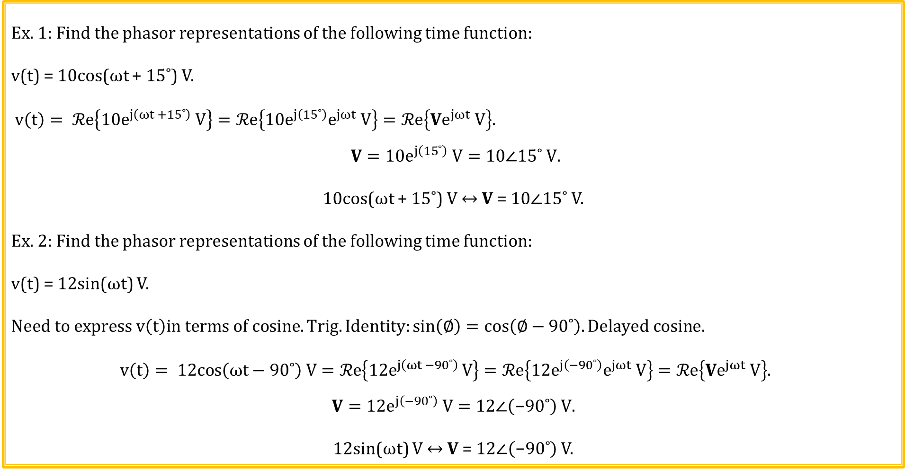
Phasor Examples
Ex. 1: Find the phasor representations of the following time function:
v(t) = 10cos(ωt + 15$˚$) V.
$v\left(t\right)= ℛe\left\{10e^{j\left(ωt +15˚\right)} V\right\}=ℛe\left\{10e^{j\left(15˚\right)}e^{jωt} V\right\}=ℛe\left\{{Ve}^{jωt} V\right\}.$
$$V=10e^{j\left(15˚\right)} V=\text{1}0∠\text{1}\text{5}˚ V\text{.}$$
10cos(ωt + 15$˚$) V ↔ V = 10$∠1$5$˚$ V.
Ex. 2: Find the phasor representations of the following time function:
v(t) = 12sin(ωt) V.
$$Need to express v\left(t\right)in terms of cosine. Trig. Identity:sin\left(∅\right)=cos\left(∅−90˚\right). Delayed cosine.$$
$$v\left(t\right)= 12cos\left(ωt−90˚\right) V=ℛe\left\{12e^{j\left(ωt −90˚\right) }V\right\}=ℛe\left\{12e^{j\left(−90˚\right)}e^{jωt} V\right\}=ℛe\left\{Ve^{jωt} V\right\}.$$
$$V=12e^{j\left(−90˚\right)} V=\text{12}∠\left(\text{−90}˚\right) \text{V}\text{.}$$
12sin(ωt) V ↔ V = 12$∠\left(\text{−90}˚\right)$ V.

Slide 10
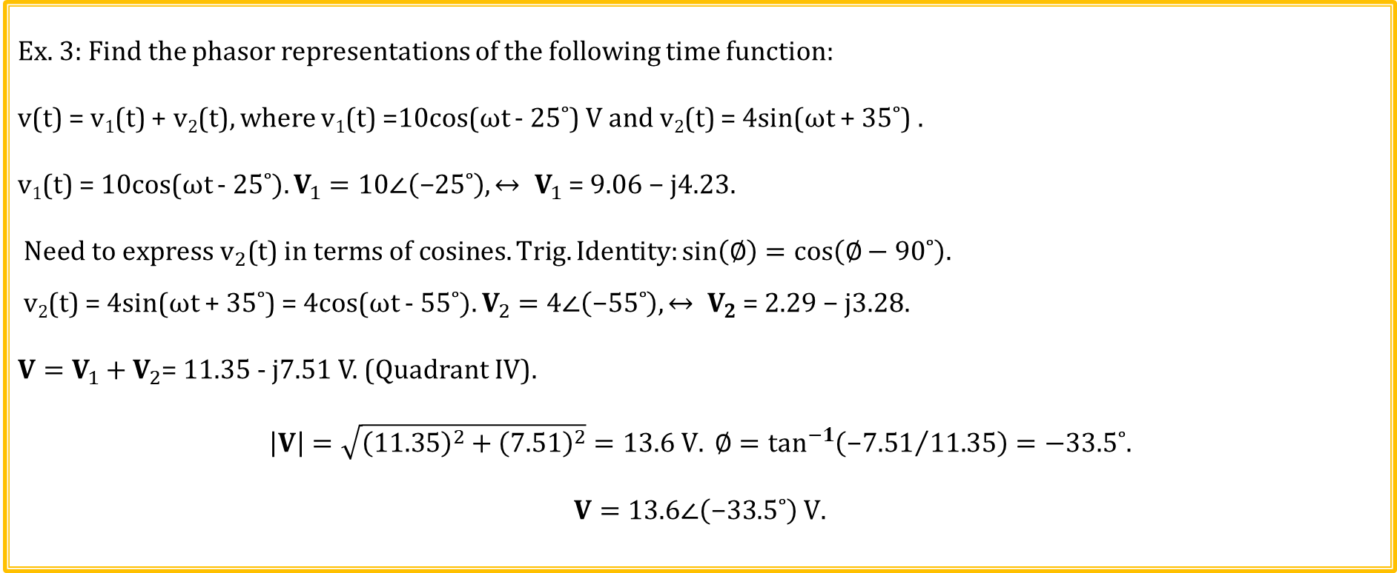
Phasor Examples (Continued)
Ex. 3: Find the phasor representations of the following time function:
v(t) = v₁(t) + v₂(t), where v₁(t) =10cos(ωt - 25$˚$) V and v₂(t) = 4sin(ωt + 35$˚$) .
v₁(t) = 10cos(ωt - 25$˚). V_{1}=10∠\left(\text{−}25˚\right),↔ V_{1}\text{ = 9.06 − }\text{j}\text{4.23}\text{.}$
$Need to express v_{2}\text{(}\text{t}\text{) }in terms of cosines. Trig. Identity:sin\left(∅\right)=cos\left(∅−90˚\right).$
v₂(t) = 4sin(ωt + 35$˚$) = 4cos(ωt - 55$˚). V_{2}=4∠\left(\text{−}55˚\right),↔ V_{2}\text{ = 2.29 − }\text{j}\text{3.28.}$
${V=V}_{1}+V_{2}$= 11.35 - j7.51 V. (Quadrant IV).
$$\left|V\right|=\sqrt{{\left(\text{11.35}\right)}^{2}+{\left(\text{7.51}\right)}^{2}}=13.6 V. ∅=\tan^{−1}\left({\text{−}\text{7.51}}/{\text{11.35}}\right)=−33.5˚.$$
$$V=13.6∠\left(\text{−}33.5˚\right) \text{V}\text{.}$$

Slide 11
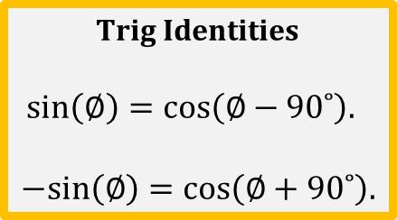
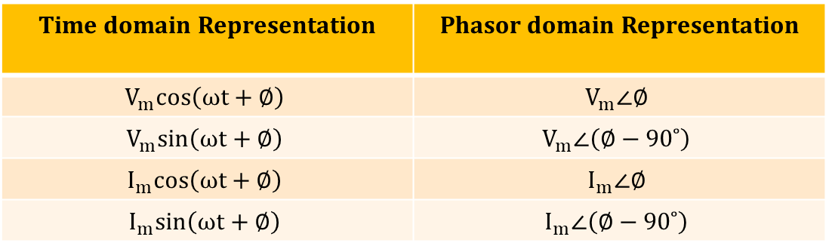
Sinusoid-Phasor Transformation
Time domain Representation | Phasor domain Representation
$$V_{m}cos\left(ωt+∅\right)$$ | $$V_{m}∠∅$$
$$V_{m}sin\left(ωt+∅\right)$$ | $$V_{m}∠\left(∅−90˚\right)$$
$$I_{m}cos\left(ωt+∅\right)$$ | $$I_{m}∠∅$$
$$I_{m}sin\left(ωt+∅\right)$$ | $$I_{m}∠\left(∅−90˚\right)$$
Trig Identities
$$sin\left(∅\right)=cos\left(∅−90˚\right).$$
$$−sin\left(∅\right)=cos\left(∅+90˚\right).$$
Poll Questions

Slide 12
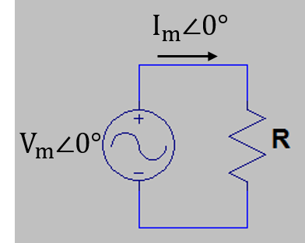
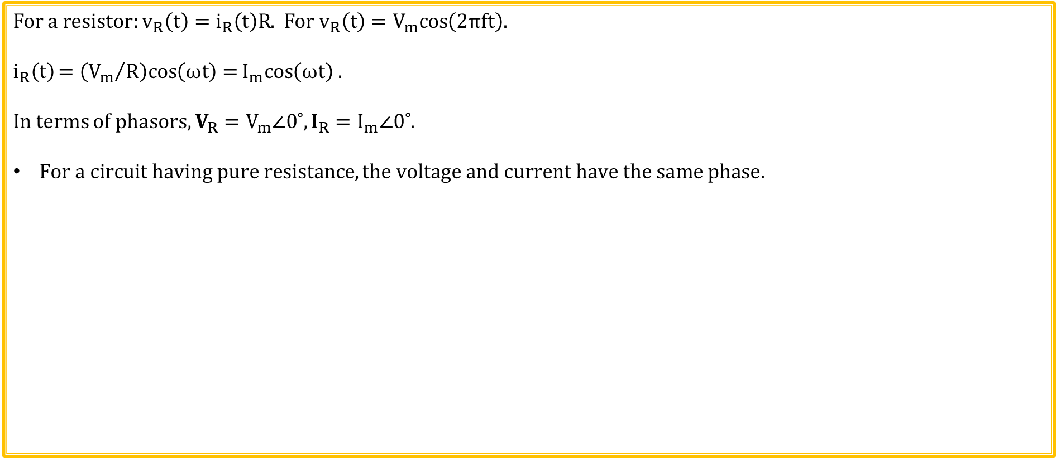
Phasor Relationship for Resistors
For a resistor: $v_{R}\left(t\right)=i_{R}\left(t\right)R$. For $v_{R}\left(t\right)=V_{m}cos\left(2πft\right).$
$$i_{R}\left(t\right)=\left({V_{m}}/R\right)cos\left(ωt\right)=I_{m}cos\left(ωt\right) .$$
In terms of phasors, $V_{R}=V_{m}∠0˚, I_{R}=I_{m}∠0˚.$
$For a circuit having pure resistance, the voltage and current have the same phase.$
Voltage and Current are Always in-phase for pure resistance.
Imaginary
I_{R}
Real
V_{R}

Slide 13
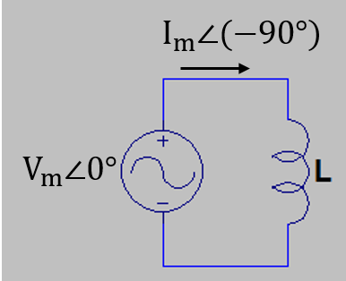
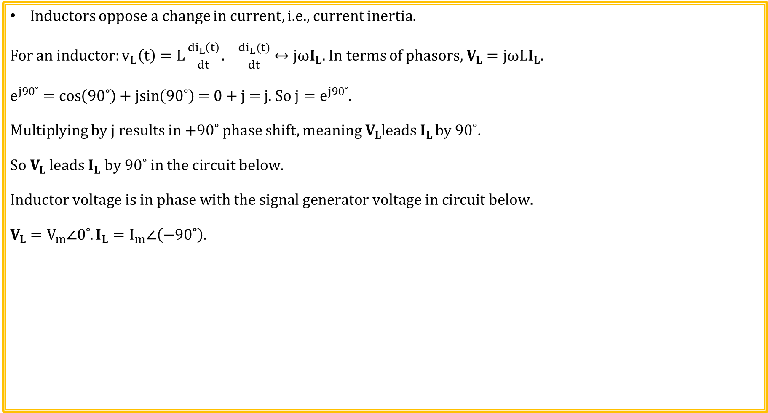
Phasor Relationship for Inductors
Inductors oppose a change in current, i.e., current inertia.
For an inductor: $v_{L}\left(t\right)=L\frac{{di}_{L}\left(t\right)}{dt}. \frac{di_{L}(t)}{dt}↔jωI_{L}.$In terms of phasors, $V_{L}={jωLI}_{L}.$
$e^{j90˚}=\cos\left(90˚\right)+\operatorname{jsin}\left(90˚\right)$ = 0 + j = j. So ${j=e}^{j90˚}$.
Multiplying by j results in +90˚ phase shift, meaning $V_{L}leads I_{L}$ by 90˚.
$$So V_{L} leads I_{L} by 90˚ in the circuit below.$$
$$Inductor voltage is in phase with the signal generator voltage in circuit below.$$
$$V_{L}=V_{m}∠0˚.I_{L}=I_{m}∠\left(−90˚\right).$$
Imaginary
Inductor Voltage Always Leads Inductor Current
by 90˚.
V_{L}
Real
I_{L}
-90˚

Slide 14
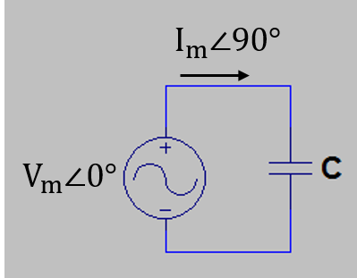
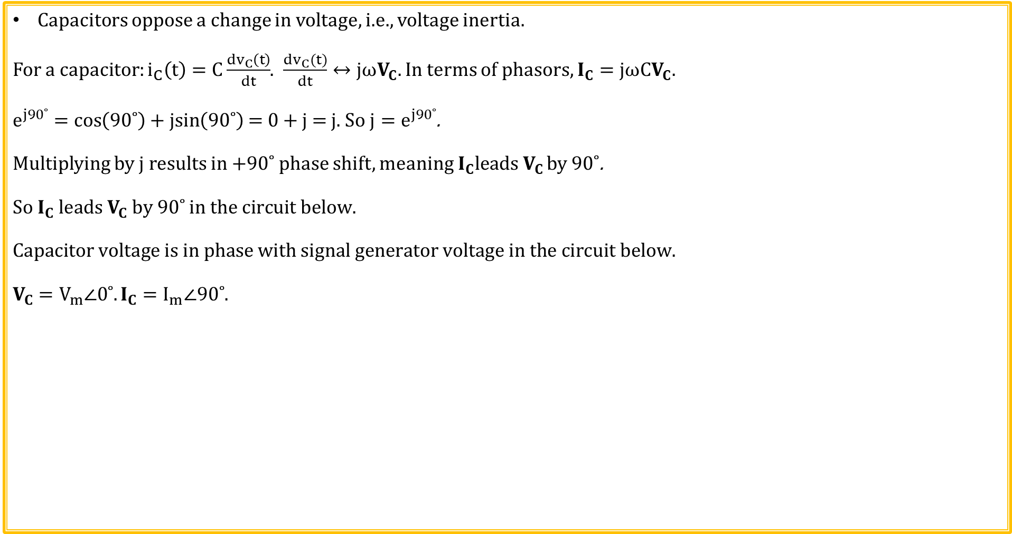
Phasor Relationship for Capacitors
Capacitors oppose a change in voltage, i.e., voltage inertia.
For a capacitor: $i_{C}\left(t\right)=C\frac{{dv}_{C}\left(t\right)}{dt}$. $\frac{dv_{C}(t)}{dt}↔jωV_{C}.$In terms of phasors, $I_{C}={jωCV}_{C}.$
$e^{j90˚}=\cos\left(90˚\right)+\operatorname{jsin}\left(90˚\right)$ = 0 + j = j. So ${j=e}^{j90˚}$.
Multiplying by j results in +90˚ phase shift, meaning $I_{C}leads V_{C}$ by 90˚.
$$So I_{C} leads V_{C} by 90˚ in the circuit below.$$
$$Capacitor voltage is in phase with signal generator voltage in the circuit below.$$
$$V_{C}=V_{m}∠0˚.I_{C}=I_{m}∠90˚.$$
Imaginary
Capacitor Current Always Leads
Capacitor Voltage by 90˚.
I_{C}
90˚
V_{C}
Real

Slide 15
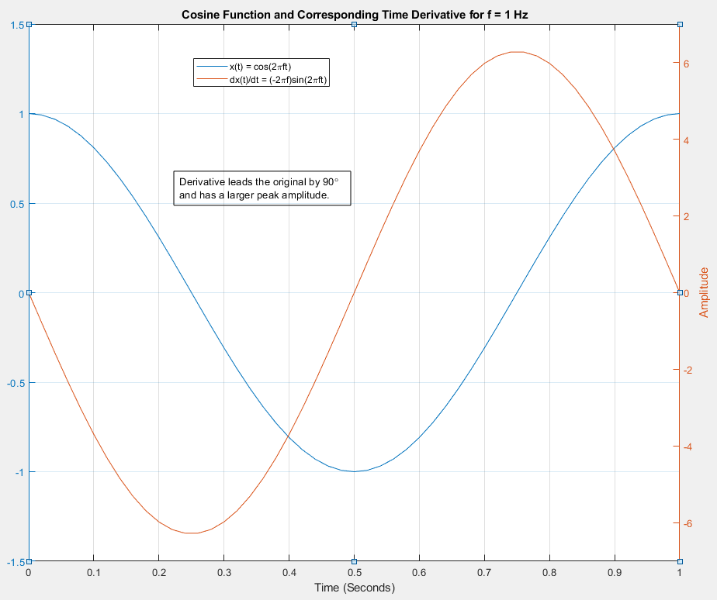
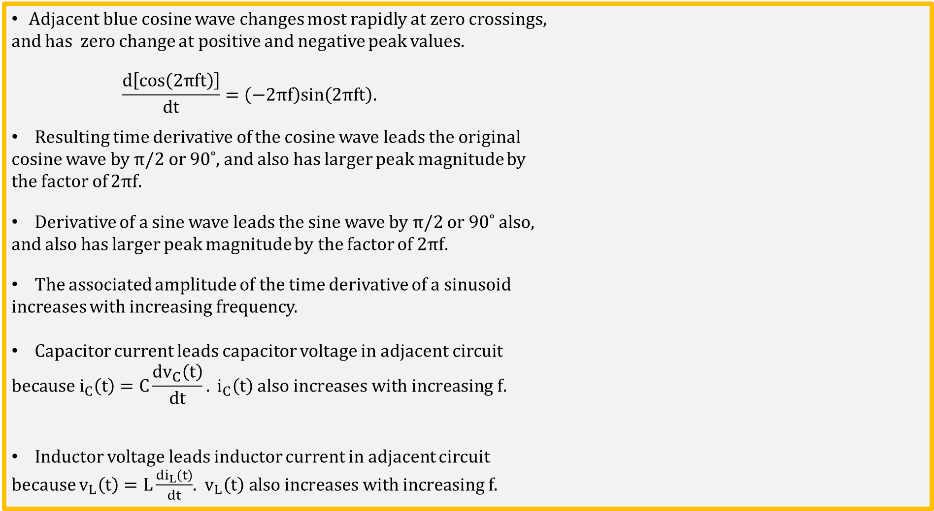
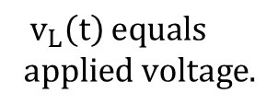
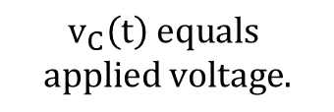
Time Derivatives and Phasors
Adjacent blue cosine wave changes most rapidly at zero crossings,
and has zero change at positive and negative peak values.
$$\frac{d\left[cos\left(2πft\right)\right]}{dt}=\left(−2πf\right)sin\left(2πft\right).$$
Resulting time derivative of the cosine wave leads the original
cosine wave by π/2 or 90˚, and also has larger peak magnitude by
the factor of 2πf.
Derivative of a sine wave leads the sine wave by π/2 or 90˚ also,
and also has larger peak magnitude by the factor of 2πf.
The associated amplitude of the time derivative of a sinusoid
increases with increasing frequency.
Capacitor current leads capacitor voltage in adjacent circuit
$$because i_{C}\left(t\right)=C\frac{{dv}_{C}\left(t\right)}{dt}. i_{C}\left(t\right) also increases with increasing f.$$
Inductor voltage leads inductor current in adjacent circuit
because $v_{L}\left(t\right)=L\frac{{di}_{L}\left(t\right)}{dt}$. $v_{L}\left(t\right) also increases with increasing f$.
$$v_{C}\left(t\right) equals$$
$$app\text{lied} \text{voltage}\text{.}$$
${ v}_{L}\left(t\right)$ $equals$
$$app\text{lied} \text{voltage}\text{.}$$

Slide 16
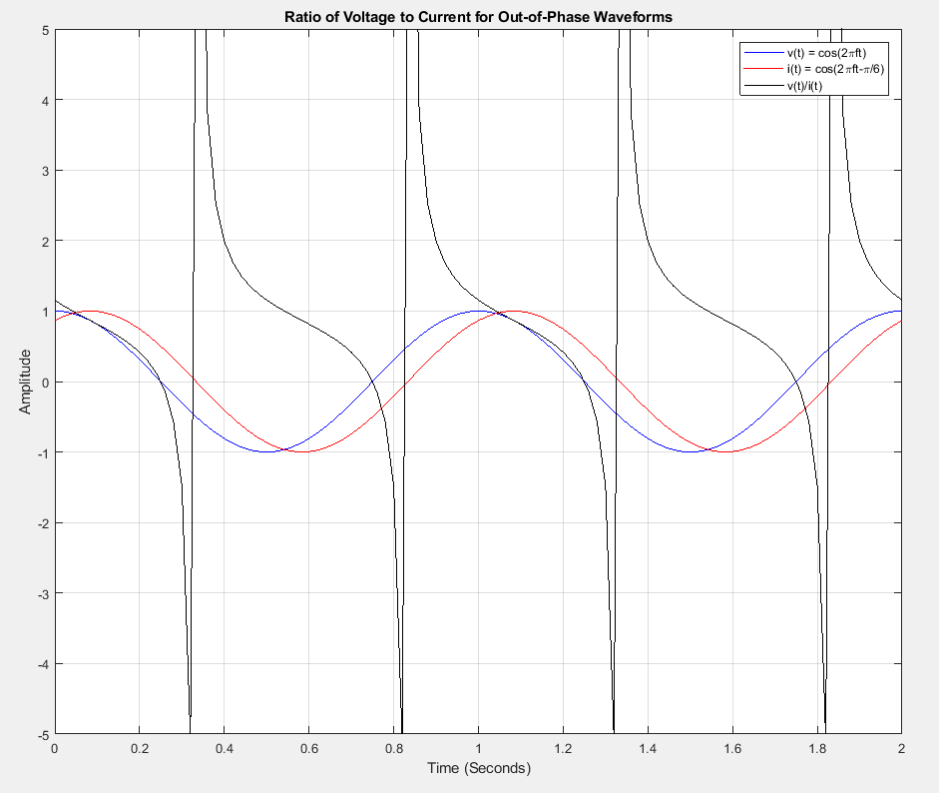
Phasors (Continued)
For pure resistive circuits, the current and
voltage are in phase, and v(t)/i(t) = R.
Adjacent graph shows the ratio of v(t)/i(t)
for v(t) and i(t) that are 30˚ out of phase.
The instantaneous resistance, i.e., R(t) = v(t)/i(t), for the
out-of-phase waveforms varies from -∞ to +∞, which isn’t
very useful.
Need another way besides R(t) = v(t)/i(t) to
characterize opposition to current flow for
circuit with inductors and capacitors.
Inductor and capacitor opposition to current flow is also frequency dependent.
Impedance Z is the term used to describe the frequency dependent opposition to current flow relationships for circuits with capacitors and/or inductors.
For a pure resistance, Z_{R} = R.

Slide 17
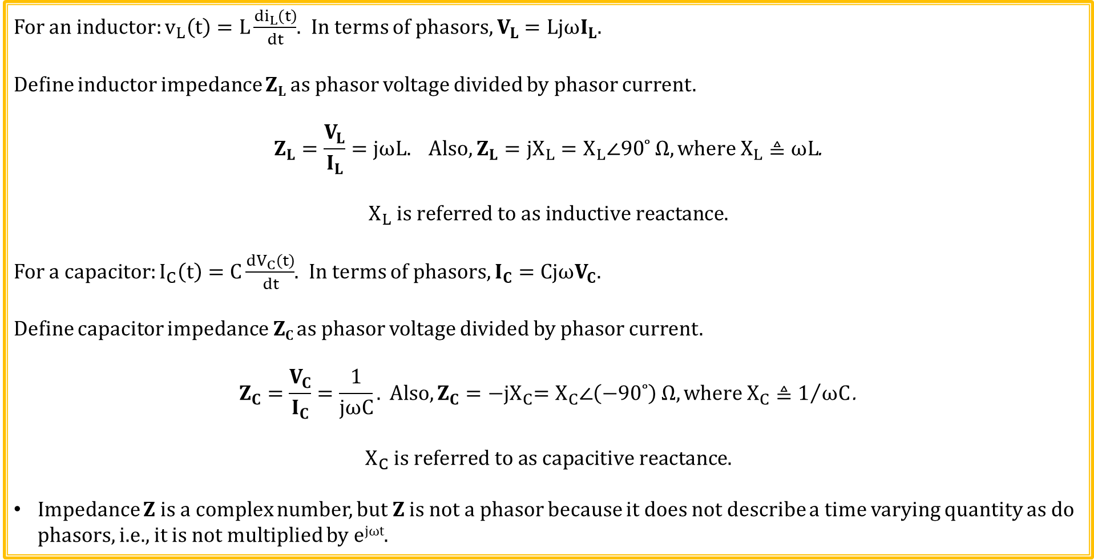
Impedance → Ratio of Phasors
For an inductor: $v_{L}\left(t\right)=L\frac{{di}_{L}\left(t\right)}{dt}$. In terms of phasors, $V_{L}=LjωI_{L}.$
Define inductor impedance Z_{L} as phasor voltage divided by phasor current.
$$Z_{L}=\frac{V_{L}}{I_{L}}=jωL. Also, Z_{L}={jX}_{L}=X_{L}∠90˚ Ω, where X_{L}≜ωL\text{.}$$
$$X_{L} is referred to as inductive reactance.$$
For a capacitor: $I_{C}\left(t\right)=C\frac{{dV}_{C}\left(t\right)}{dt}$. In terms of phasors, $I_{C}=CjωV_{C}.$
Define capacitor impedance Z_{C} as phasor voltage divided by phasor current.
$$Z_{C}=\frac{V_{C}}{I_{C}}=\frac{1}{jωC}. Also, Z_{C}={−jX}_{C}=X_{C}∠\left(−90˚\right) Ω, where X_{C}≜1/{ωC}\text{.}$$
$$X_{C} is referred to as capacitive reactance.$$
Impedance Z is a complex number, but Z is not a phasor because it does not describe a time varying quantity as do phasors, i.e., it is not multiplied by e^{jωt}.

Slide 18
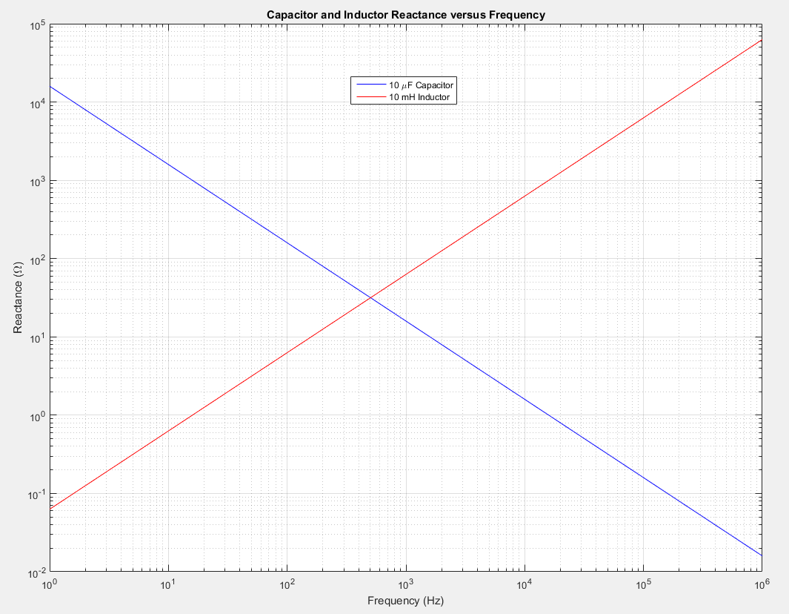
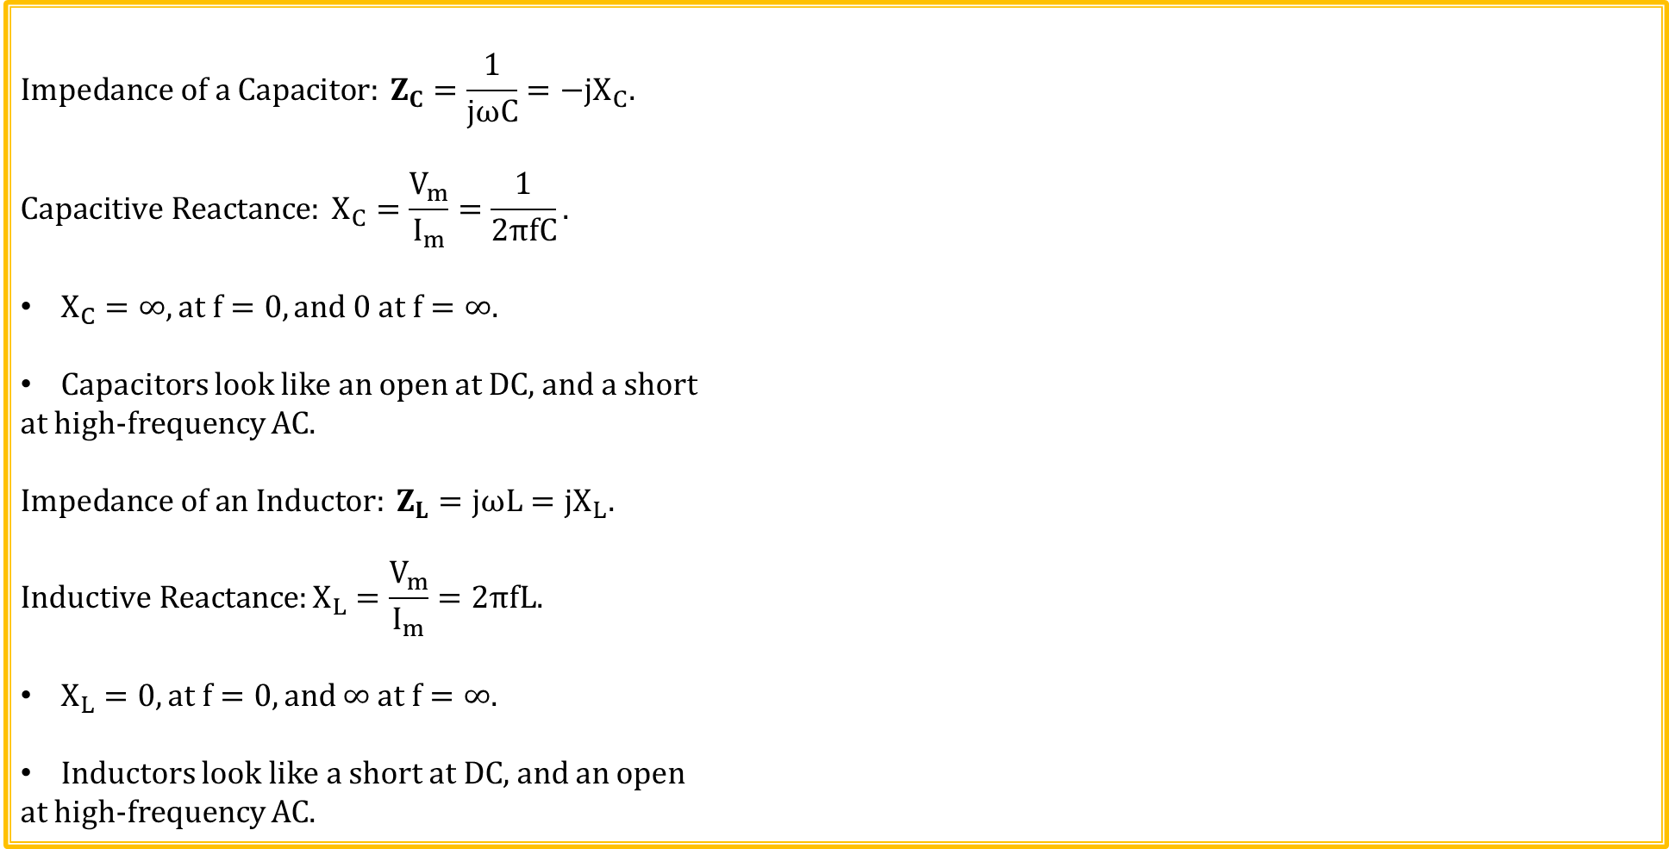
Reactance – Magnitude of Impedance
$$Impedance of a Capacitor: Z_{C}=\frac{1}{jωC}=−jX_{C}.$$
$$Capacitive Reactance: X_{C}=\frac{V_{m}}{I_{m}}=\frac{1}{2πfC}.$$
$X_{C}=∞, at f=0, and 0 at f=∞.$
Capacitors look like an open at DC, and a short
at high-frequency AC.
$$Impedance of an Inductor: Z_{L}=jωL=jX_{L}.$$
$$Inductive Reactance:X_{L}=\frac{V_{m}}{I_{m}}=2πfL.$$
$X_{L}=0, at f=0, and ∞ at f=∞.$
Inductors look like a short at DC, and an open
at high-frequency AC.

Slide 19
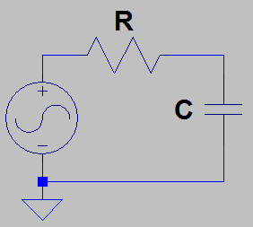
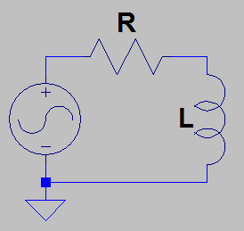
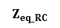
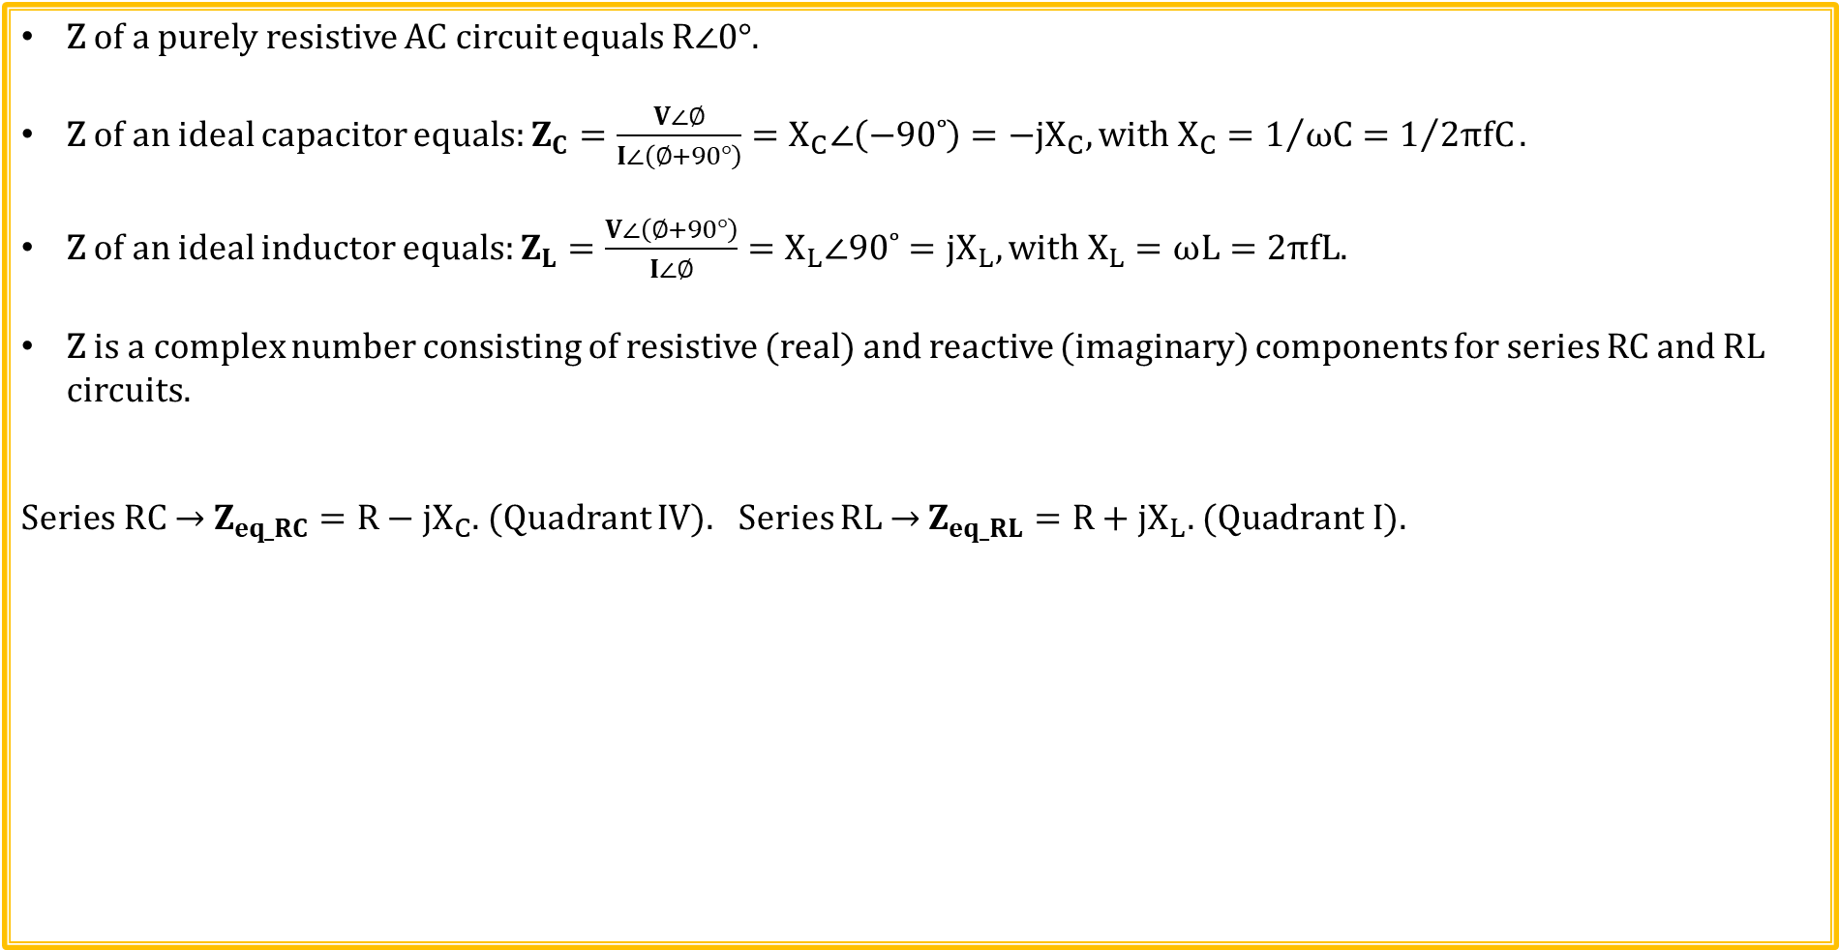
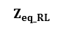
Impedance for Series RC and RL Circuits
Z of a purely resistive AC circuit equals $R∠0°$.
Z of an ideal capacitor equals: $Z_{C}=\frac{V∠∅}{I∠\left(∅+90°\right)}=X_{C}∠\left(−90˚\right)=−jX_{C}, with X_{C}=1/{ωC}=1/{2πfC}.$
Z of an ideal inductor equals: $Z_{L}=\frac{V∠\left(∅+90°\right)}{I∠∅}=X_{L}∠90˚=jX_{L}, with X_{L}=ωL=2πfL.$
Z is a complex number consisting of resistive (real) and reactive (imaginary) components for series RC and RL circuits.
$\text{Series} \text{RC}\text{ → }Z_{eq_RC}=R−jX_{C}$. (Quadrant IV). Series RL → $Z_{eq_RL}=R+jX_{L}\text{. }\text{(}\text{Quadrant} \text{I}\text{). }$
Poll Questions
Imaginary
Imaginary
$$Z_{eq_RL}$$
X_{L}
R
θ
Real
Real
R
X_{C}
θ
$$Z_{eq_RC}$$

Slide 20
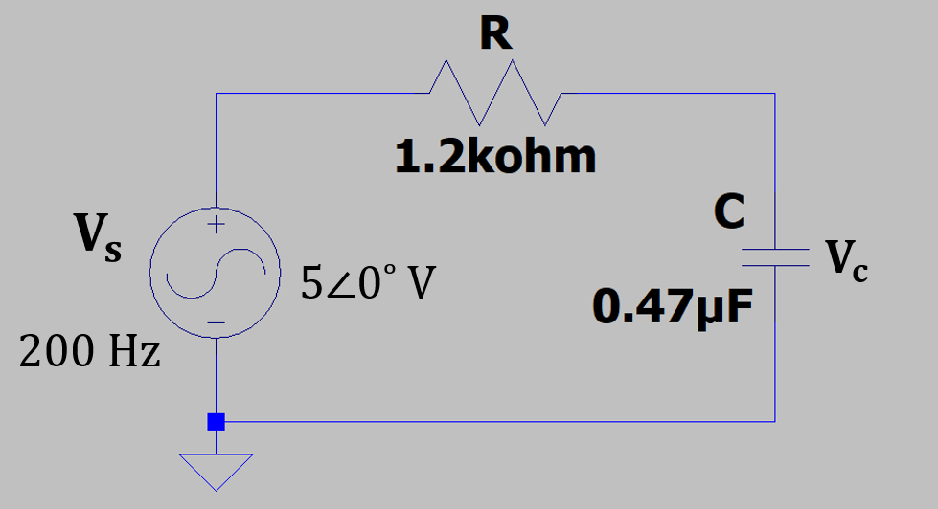
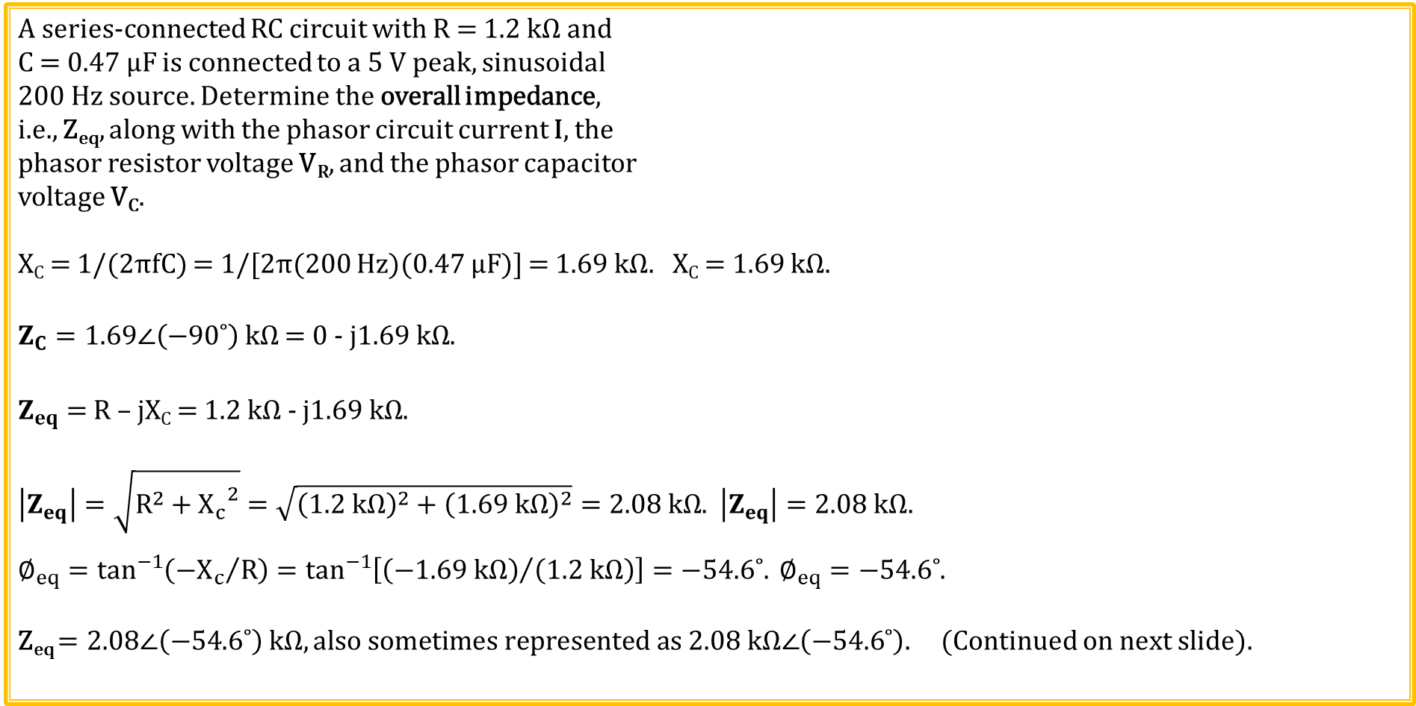
Phasor RC Example 1
A series-connected RC circuit with R = 1.2 kΩ and
C = 0.47 µF is connected to a 5 V peak, sinusoidal
200 Hz source. Determine the overall impedance,
i.e., Z_{eq}, along with the phasor circuit current I, the
phasor resistor voltage V_{R}, and the phasor capacitor
voltage V_{C}.
X_{C} = 1/(2πfC) = 1/[2π(200 Hz)(0.47 µF)] = 1.69 kΩ. X_{C} = 1.69 kΩ.
$Z_{C}=1.69∠\left(−90˚\right) kΩ$ = 0 - j$1.69 kΩ$.
$Z_{eq}=$ R – jX_{C} = 1.2 kΩ - j$1.69 kΩ$.
$\left|Z_{eq}\right|=\sqrt{R^{2}+{X_{c}}^{2}}=\sqrt{{\left(1.2 kΩ\right)}^{2}+{\left(1.69 kΩ\right)}^{2}}=2.08 kΩ$. $\left|Z_{eq}\right|=2.08 kΩ$.
$∅_{eq}=\tan^{−1}\left({{−X}_{c}}/R\right)=\tan^{−1}\left[{\left(−1.69 kΩ\right)}/{\left(1.2 kΩ\right)}\right]=−54.6˚. ∅_{eq}=−54.6˚$.
Z_{eq} $=2.08∠\left(−54.6˚\right)$ $kΩ, also sometimes represented as 2.08 kΩ∠\left(−54.6˚\right)\text{.}$ (Continued on next slide).

Slide 21
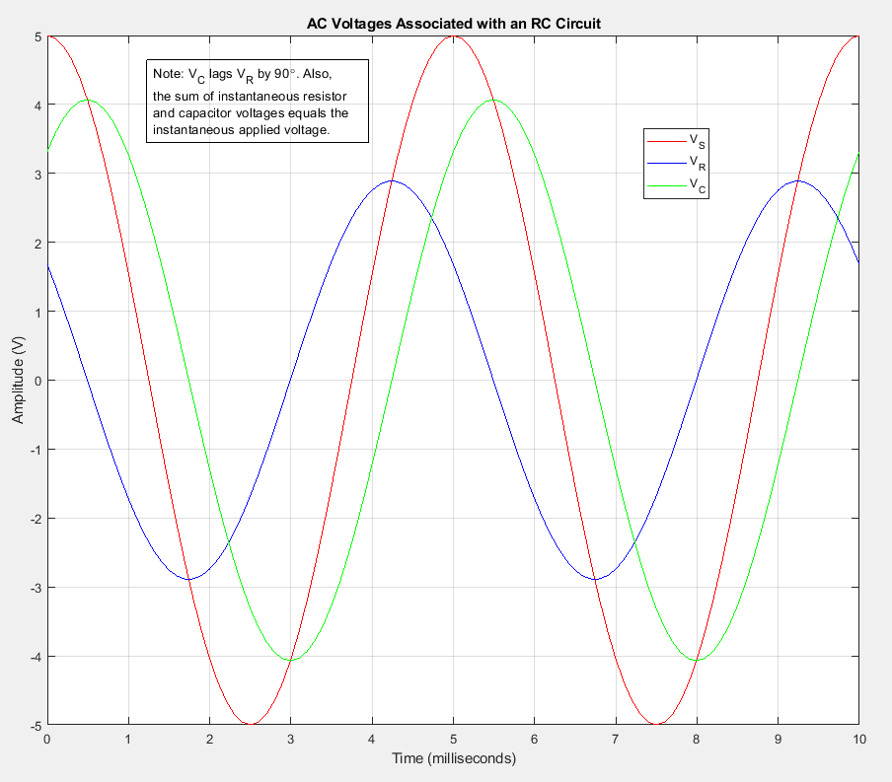
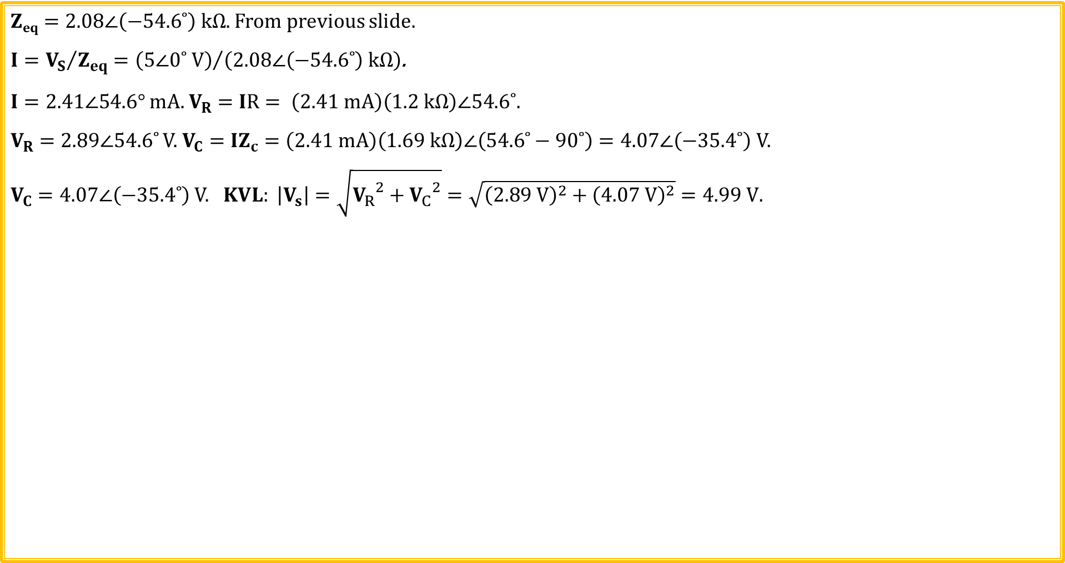
Phasor RC Example 1 (Continued)
$\text{Z}\text{eq}=2.08∠\left(−54.6˚\right) kΩ.$ From previous slide.
$I={V_{S}}/{Z_{eq}}={\left(5∠0˚ V\right)}/{\left(2.08∠\left(−54.6˚\right) kΩ\right)}$.
$I=2.41∠54.6°$ mA. $V_{R}=IR= \left(2.41 mA\right)\left(1.2 kΩ\right)∠54.6˚.$
$V_{R}=2.89∠54.6˚$ V. $V_{C}=IZ_{c}=\left(2.41 mA\right)\left(1.69 kΩ\right)∠\left(54.6˚−90˚\right)=4.07∠\left(−35.4˚\right)$ V.
$V_{C}=4.07∠\left(−35.4˚\right)$ V. $KVL: \left|V_{s}\right|=\sqrt{{V_{R}}^{2}+{V_{C}}^{2}}=\sqrt{{\left(2.89 V\right)}^{2}+{\left(4.07 V\right)}^{2}}=4.99 V.$
Imaginary
Capacitor Current Always Leads Capacitor Voltage by 90˚. Therefore, V_{R} leads V_{C} by 90˚.
KVL and KCL also apply at each instant of time.
V_{R}
90˚
V_{S}
Real
V_{C}

Slide 22
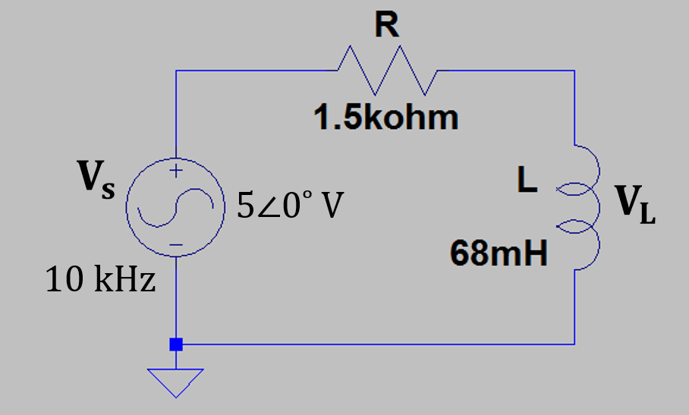
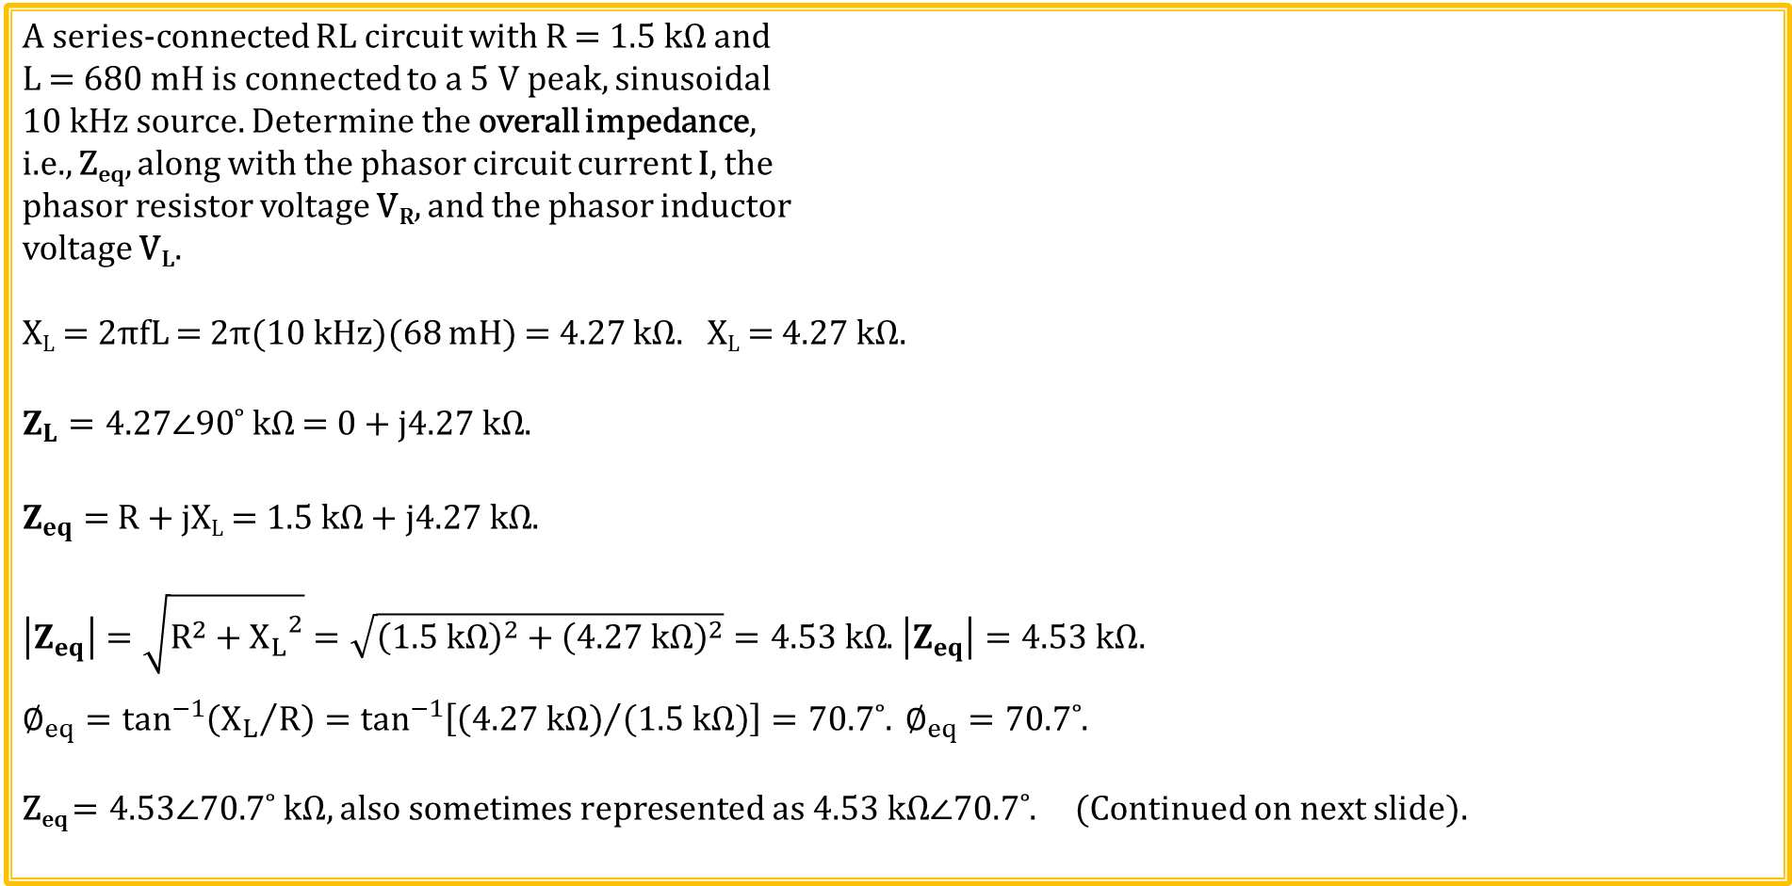
Phasor RL Example 1
A series-connected RL circuit with R = 1.5 kΩ and
L = 680 mH is connected to a 5 V peak, sinusoidal
10 kHz source. Determine the overall impedance,
i.e., Z_{eq}, along with the phasor circuit current I, the
phasor resistor voltage V_{R}, and the phasor inductor
voltage V_{L}.
X_{L} = 2πfL = 2π(10 kHz)(68 mH) = 4.27 kΩ. X_{L} = 4.27 kΩ.
$Z_{L}=4.27∠90˚ kΩ$ = 0 + j$4.27 kΩ$.
$Z_{eq}=$ R + jX_{L} = 1.5 kΩ + j$4.27 kΩ$.
$\left|Z_{eq}\right|=\sqrt{R^{2}+{X_{L}}^{2}}=\sqrt{{\left(1.5 kΩ\right)}^{2}+{\left(4.27 kΩ\right)}^{2}}=4.53 kΩ$. $\left|Z_{eq}\right|=4.53 kΩ$.
$∅_{eq}=\tan^{−1}\left({X_{L}}/R\right)=\tan^{−1}\left[{\left(4.27 kΩ\right)}/{\left(1.5 kΩ\right)}\right]=70.7˚. ∅_{eq}=70.7˚$.
Z_{eq} $=4.53∠70.7˚$ $kΩ, also sometimes represented as 4.53 kΩ∠70.7˚\text{.}$ (Continued on next slide).

Slide 23
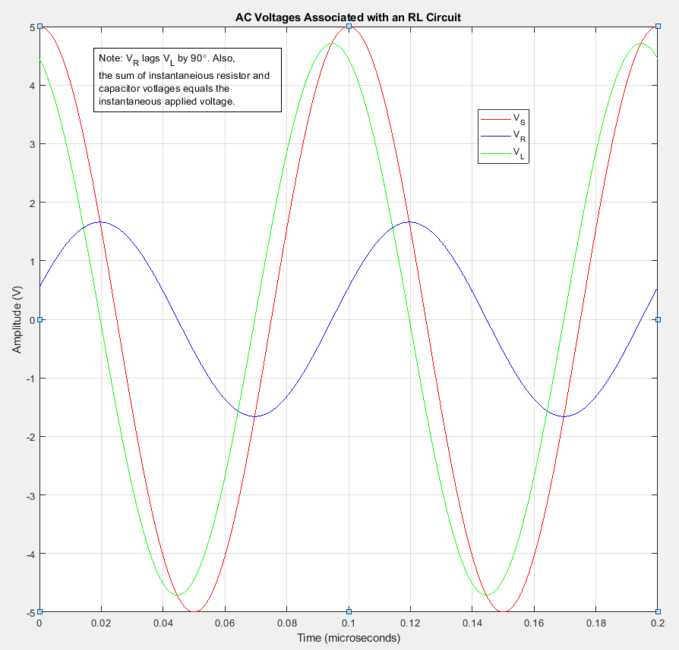
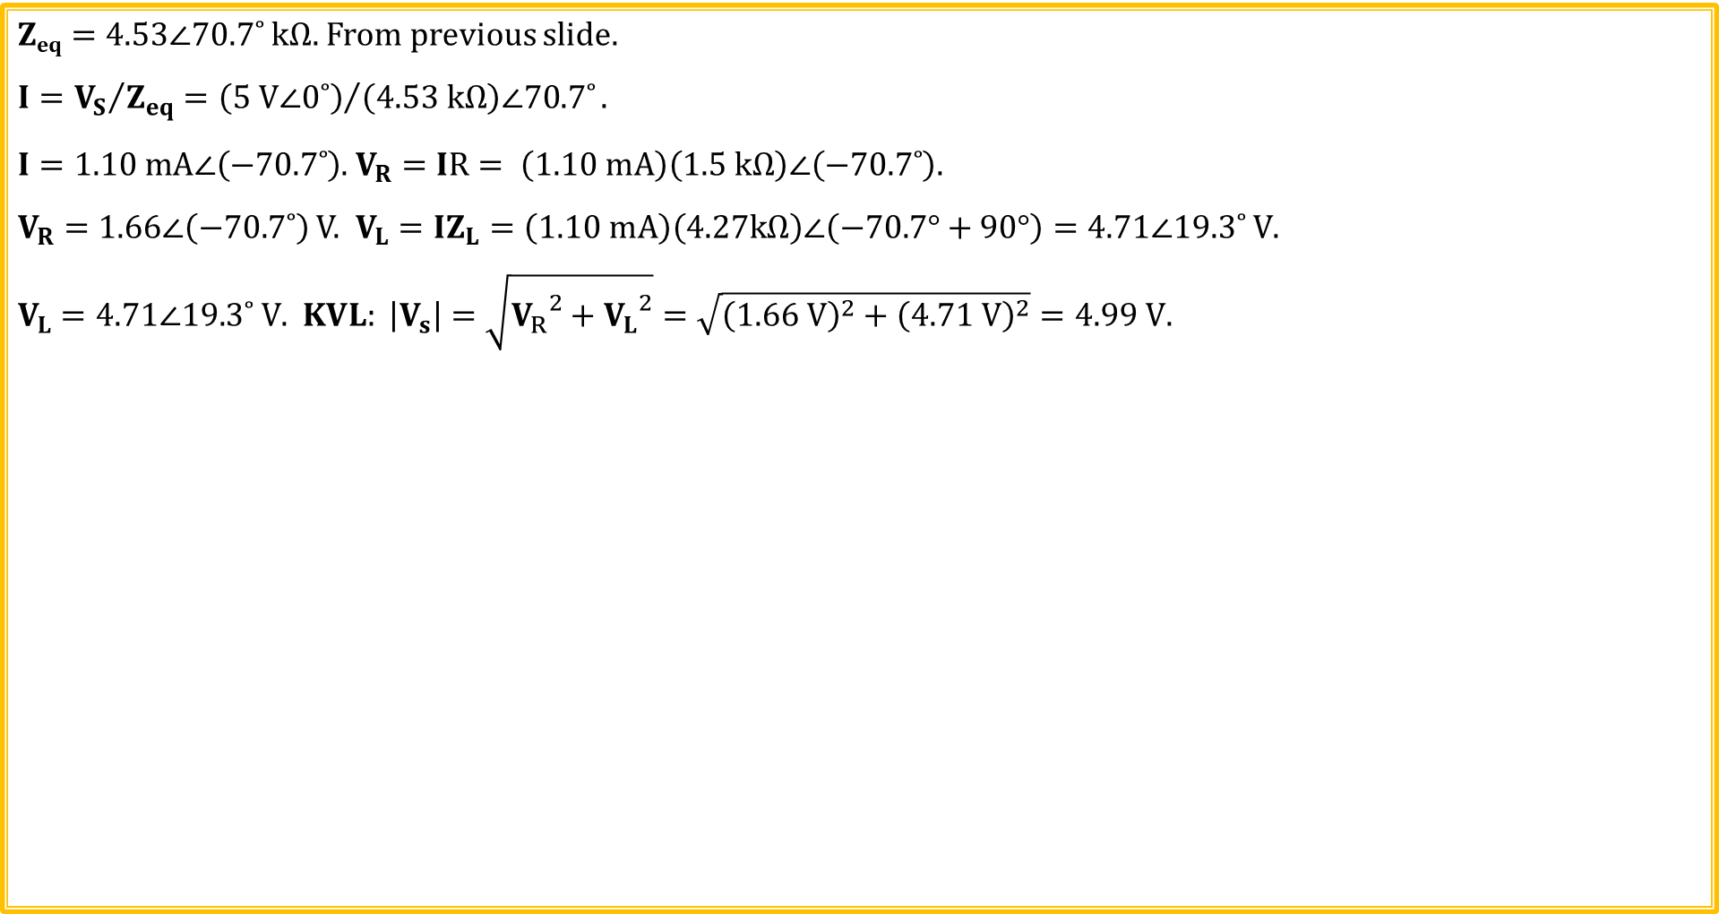
Phasor RL Example 1 (Continued)
$\text{Z}\text{eq}=4.53∠70.7˚ kΩ\text{.}$ From previous slide.
$$I={V_{S}}/{Z_{eq}}={\left(5 V∠0˚\right)}/{\left(4.53 kΩ\right)∠70.7˚}.$$
$I=1.10 mA∠\left(−70.7˚\right)$. $V_{R}=IR= \left(1.10 mA\right)\left(1.5 kΩ\right)∠\left(−70.7˚\right).$
$V_{R}=1.66∠\left(−70.7˚\right)$ V. $V_{L}=IZ_{L}=\left(1.10 mA\right)\left(4.27kΩ\right)∠\left(−70.7°+90°\right)=4.71∠19.3˚ V$.
$V_{L}=4.71∠19.3˚ V$. $KVL: \left|V_{s}\right|=\sqrt{{V_{R}}^{2}+{V_{L}}^{2}}=\sqrt{{\left(1.66 V\right)}^{2}+{\left(4.71 V\right)}^{2}}=4.99 V.$
Imaginary
Inductor Voltage Always Leads Inductor Current by 90˚. Therefore, V_{L} leads V_{R} by 90˚.
KVL and KCL also apply at each instant of time.
V_{L}
90˚
V_{S}
Real
V_{R}

Slide 24
Phasor Signal Representation
$$v\left(t\right)=r\cos\left(ωt+∅\right)=ℛe\left\{{re}^{j\left(ωt+∅\right)}\right\}.$$
$${re}^{j\left(ωt+∅\right)}={re}^{j∅}e^{jωt}.$$
$$v\left(t\right)=ℛe\left\{{re}^{j∅}e^{jωt}\right\}.$$
$Define V= {re}^{j∅}$ $→$ Referred to as a phasor, i.e., phase vector.
Phasors are complex quantities that are not a function of time.
Phasors are used in ac steady-state analysis having a single common frequency.
${re}^{j∅}$ ↔ $r∠∅→Phasor Notation.$
$Then v\left(t\right)=ℛe\left\{{Ve}^{jωt}\right\}.$ Where phasor $V= {re}^{j∅}$.

Slide 25
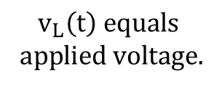
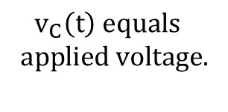
Time Derivatives and Phasors
Adjacent blue cosine wave changes most rapidly at zero crossings,
and has zero change at positive and negative peak values.
$$\frac{d\left[cos\left(2πft\right)\right]}{dt}=\left(−2πf\right)sin\left(2πft\right).$$
Resulting time derivative of the cosine wave leads the original
cosine wave by π/2 or 90˚, and also has larger peak magnitude by
the factor of 2πf.
Derivative of a sine wave leads the sine wave by π/2 or 90˚ also,
and also has larger peak magnitude by the factor of 2πf.
The associated amplitude of the time derivative of a sinusoid
increases with increasing frequency.
Capacitor current leads capacitor voltage in adjacent circuit
$$because i_{C}\left(t\right)=C\frac{{dv}_{C}\left(t\right)}{dt}. i_{C}\left(t\right) also increases with increasing f.$$
Inductor voltage leads inductor current in adjacent circuit
because $v_{L}\left(t\right)=L\frac{{di}_{L}\left(t\right)}{dt}$. $v_{L}\left(t\right) also increases with increasing f$.
$v_{C}\left(t\right)$ $equals$
$$app\text{lied} \text{voltage}\text{.}$$
$$v_{L}\left(t\right) equals$$
$$app\text{lied} \text{voltage}\text{.}$$

Slide 26
Impedance for Series RC and RL Circuits
Z of a purely resistive AC circuit equals $R∠0°$.
Z of an ideal capacitor equals: $Z_{C}=\frac{V∠∅}{I∠\left(∅+90°\right)}=X_{C}∠\left(−90˚\right)=−jX_{C}, with X_{C}=1/{ωC}=1/{2πfC}.$
Z of an ideal inductor equals: $Z_{L}=\frac{V∠\left(∅+90°\right)}{I∠∅}=X_{L}∠90˚=jX_{L}, with X_{L}=ωL=2πfL.$
Z is a complex number consisting of resistive (real) and reactive (imaginary) components for series RC and RL circuits.
$\text{Series} \text{RC}\text{ → }Z_{eq_RC}=R−jX_{C}$. (Quadrant IV). Series RL → $Z_{eq_RL}=R+jX_{L}\text{. }\text{(}\text{Quadrant} \text{I}\text{). }$
Imaginary
Imaginary
$$Z_{eq_RL}$$
X_{L}
R
θ
Real
Real
R
X_{C}
θ
$$Z_{eq_RC}$$

Slide 27
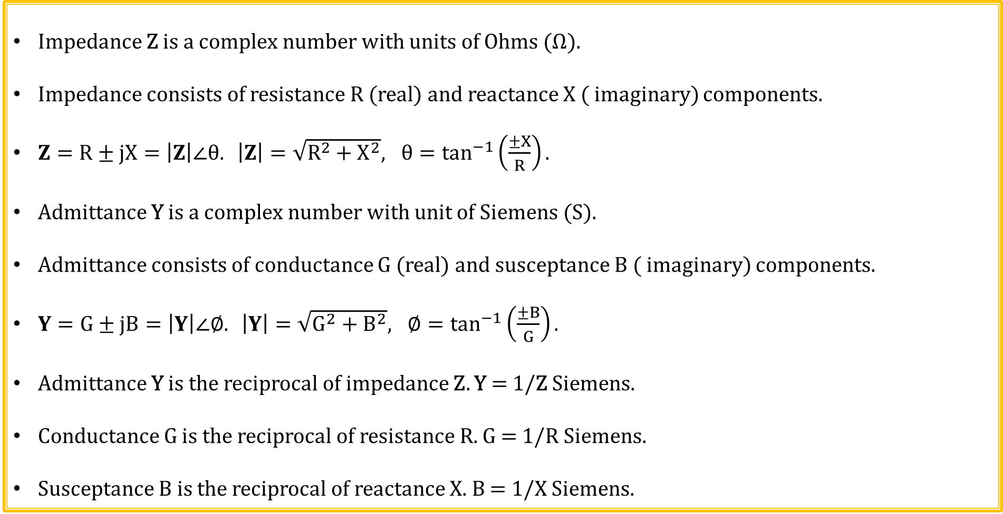
Impedance and Admittance
Impedance Z is a complex number with units of Ohms (Ω).
Impedance consists of resistance R (real) and reactance X ( imaginary) components.
$Z=R±jX=\left|Z\right|∠θ. \left|Z\right|=\sqrt{R^{2}+X^{2}}, θ=\tan^{−1}\left(\frac{±X}{R}\right).$
Admittance Y is a complex number with unit of Siemens (S).
Admittance consists of conductance G (real) and susceptance B ( imaginary) components.
$Y=G±jB=\left|Y\right|∠∅. \left|Y\right|=\sqrt{G^{2}+B^{2}}, ∅=\tan^{−1}\left(\frac{±B}{G}\right).$
Admittance Y is the reciprocal of impedance Z. Y = 1/Z Siemens.
Conductance G is the reciprocal of resistance R. G = 1/R Siemens.
Susceptance B is the reciprocal of reactance X. B = 1/X Siemens.

Slide 28
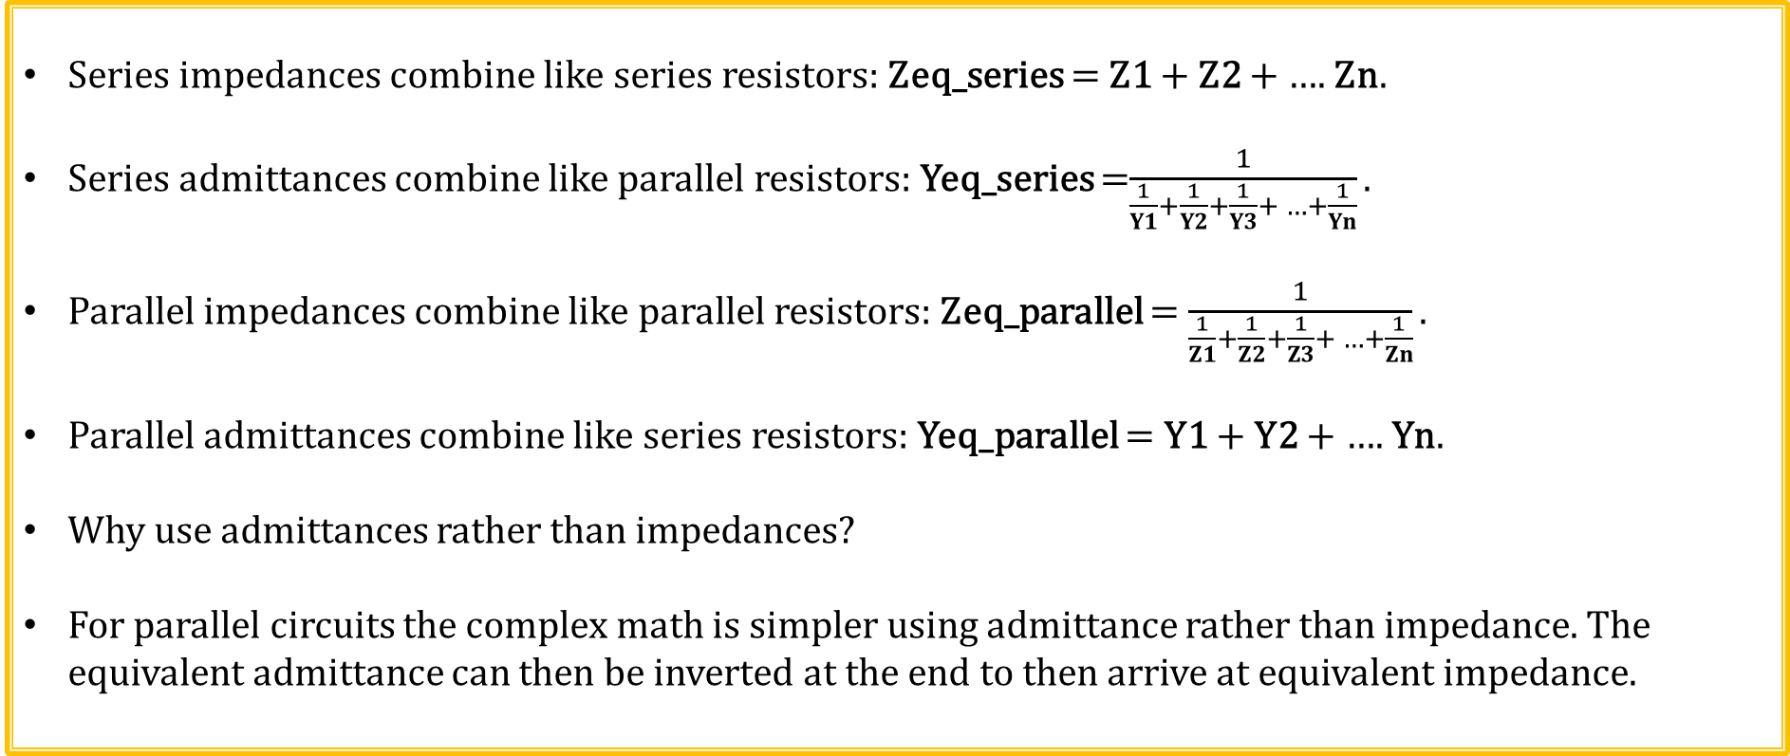
Impedance and Admittance (Continued)
Series impedances combine like series resistors: Zeq_series = Z1 + Z2 + …. Zn.
Series admittances combine like parallel resistors: Yeq_series =$\frac{1}{\frac{1}{Y1}+\frac{1}{Y2}+\frac{1}{Y3}+ …+\frac{1}{Yn}}.$
Parallel impedances combine like parallel resistors: Zeq_parallel = $\frac{1}{\frac{1}{Z1}+\frac{1}{Z2}+\frac{1}{Z3}+ …+\frac{1}{Zn}}.$
Parallel admittances combine like series resistors: Yeq_parallel = Y1 + Y2 + …. Yn$.$
Why use admittances rather than impedances?
For parallel circuits the complex math is simpler using admittance rather than impedance. The equivalent admittance can then be inverted at the end to then arrive at equivalent impedance.

Slide 29
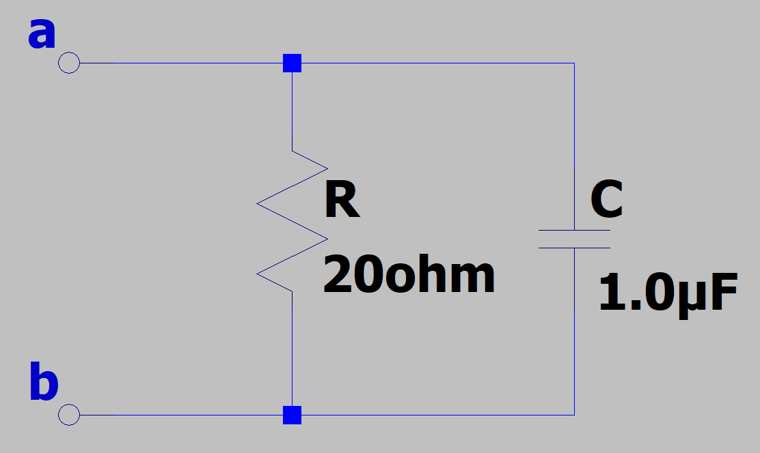
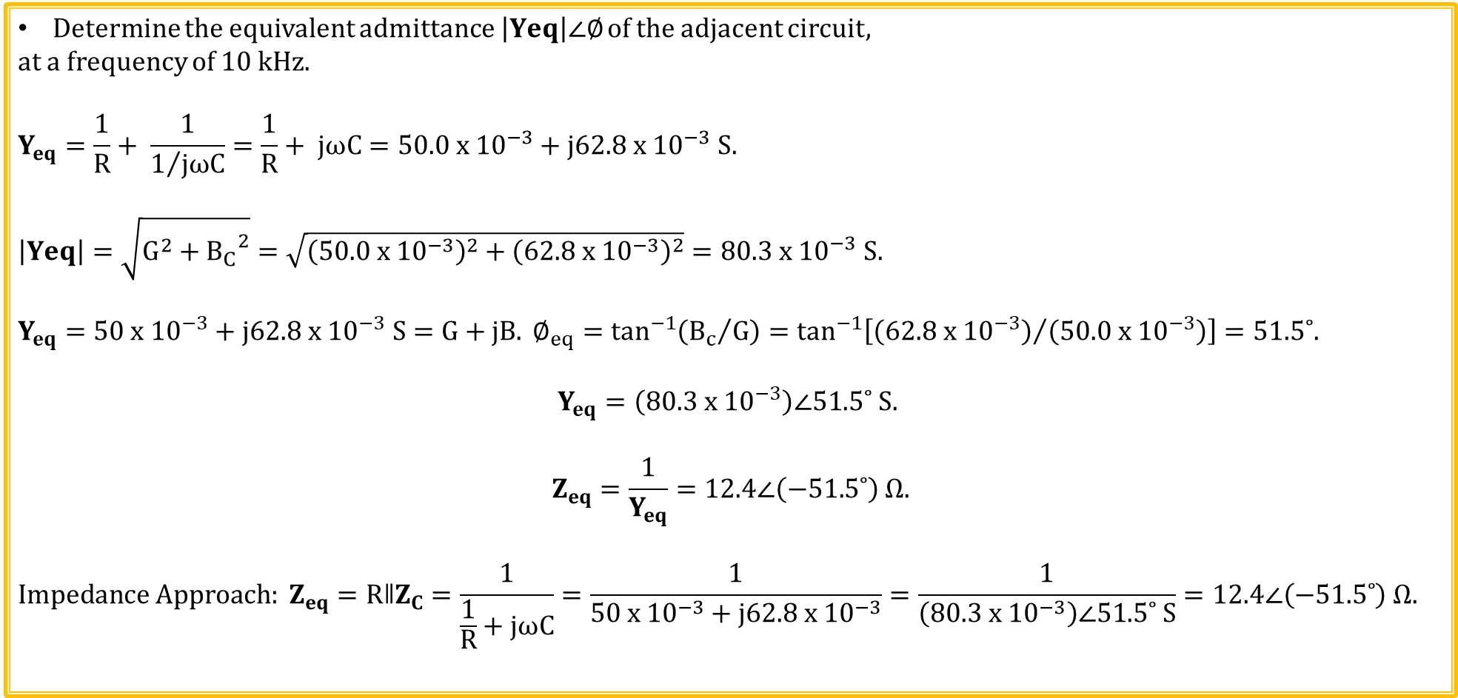
Admittance Example 1
Determine the equivalent admittance $\left|Yeq\right|∠∅$ of the adjacent circuit,
at a frequency of 10 kHz.
$$Y_{eq}=\frac{1}{R}+ \frac{1}{1/{jωC}}=\frac{1}{R}+ jωC=50.0 x {10}^{−3}+j62.8 x {10}^{−3} S.$$
$$\left|Yeq\right|=\sqrt{G^{2}+{B_{C}}^{2}}=\sqrt{{\left(50.0 x {10}^{−3}\right)}^{2}+{\left(62.8 x {10}^{−3}\right)}^{2}}=80.3 x {10}^{−3} S.$$
$$Y_{eq}=50 x {10}^{−3}+j62.8 x {10}^{−3} S=G+jB. ∅_{eq}=\tan^{−1}\left({B_{c}}/G\right)=\tan^{−1}\left[{\left(62.8 x {10}^{−3}\right)}/{\left(50.0 x {10}^{−3}\right)}\right]=51.5˚.$$
$$Y_{eq}=\left(80.3 x {10}^{−3}\right)∠51.5˚ S.$$
$$Z_{eq}=\frac{1}{Y_{eq}}=12.4∠\left(−51.5˚\right) Ω.$$
$$Impedance Approach: Z_{eq}=RǁZ_{C}=\frac{1}{\frac{1}{R}+jωC}=\frac{1}{50 x {10}^{−3}+j62.8 x {10}^{−3}}=\frac{1}{\left(80.3 x {10}^{−3}\right)∠51.5˚ S}=12.4∠\left(−51.5˚\right) Ω.$$

Slide 30
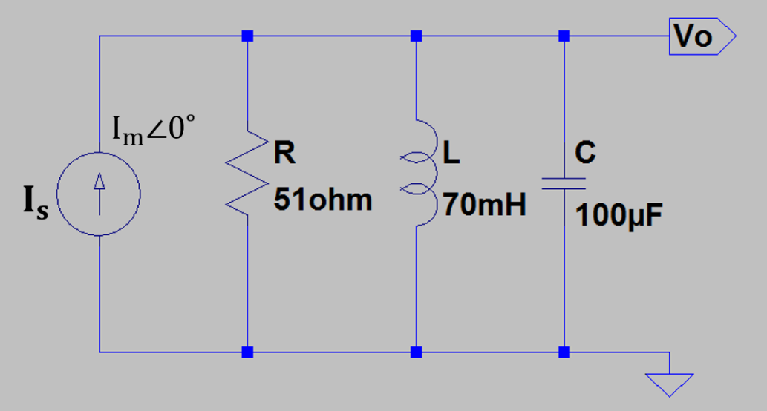
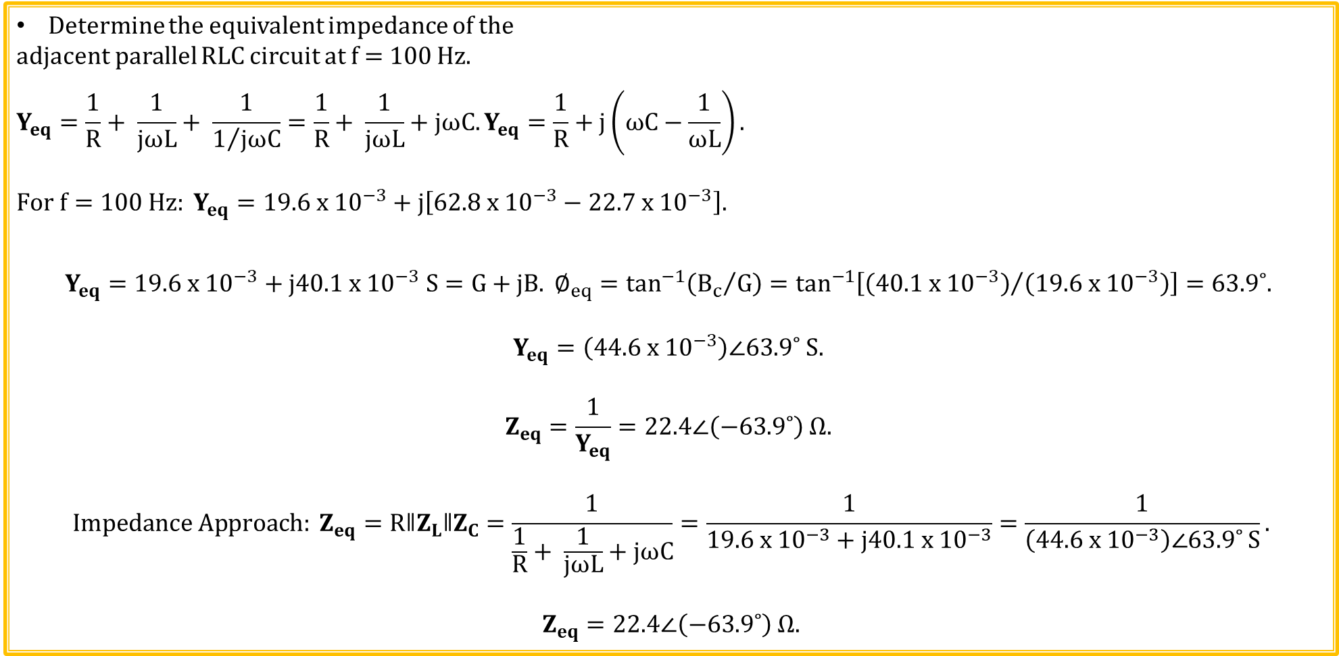
Admittance Example 2
Determine the equivalent impedance of the
adjacent parallel RLC circuit at f = 100 Hz.
$$Y_{eq}=\frac{1}{R}+ \frac{1}{jωL}+ \frac{1}{1/{jωC}}=\frac{1}{R}+ \frac{1}{jωL}+jωC.Y_{eq}=\frac{1}{R}+j\left(ωC−\frac{1}{ωL}\right).$$
$$For f=100 Hz: Y_{eq}=19.6 x {10}^{−3}+j\left[62.8 x {10}^{−3}−22.7 x {10}^{−3}\right].$$
$$Y_{eq}=19.6 x {10}^{−3}+j40.1 x {10}^{−3} S=G+jB. ∅_{eq}=\tan^{−1}\left({B_{c}}/G\right)=\tan^{−1}\left[{\left(40.1 x {10}^{−3}\right)}/{\left(19.6 x {10}^{−3}\right)}\right]=63.9˚.$$
$$Y_{eq}=\left(44.6 x {10}^{−3}\right)∠63.9˚ S.$$
$$Z_{eq}=\frac{1}{Y_{eq}}=22.4∠\left(−63.9˚\right) Ω.$$
$$Impedance Approach: Z_{eq}=RǁZ_{L}ǁZ_{C}=\frac{1}{\frac{1}{R}+ \frac{1}{jωL}+jωC}=\frac{1}{19.6 x {10}^{−3}+j40.1 x {10}^{−3}}=\frac{1}{\left(44.6 x {10}^{−3}\right)∠63.9˚ S}.$$
$$Z_{eq}=22.4∠\left(−63.9˚\right) Ω.$$

Slide 31
Phasors and Impedance Review Quiz 1 of 6
Phasors vary with time.
1. True.
2. False.
2. False. Phasors corresponds to the amplitude and phase of a time varying sinusoids. So while the sinusoid varies with time, its amplitude and phase does not.
Phasor voltages and currents are not a function of frequency.
1. True.
2. False.
2. False. Phasor voltages and currents are a function of frequency. Consequently, numeric results from phasor analysis are only valid for a single frequency sinusoid.

Slide 32
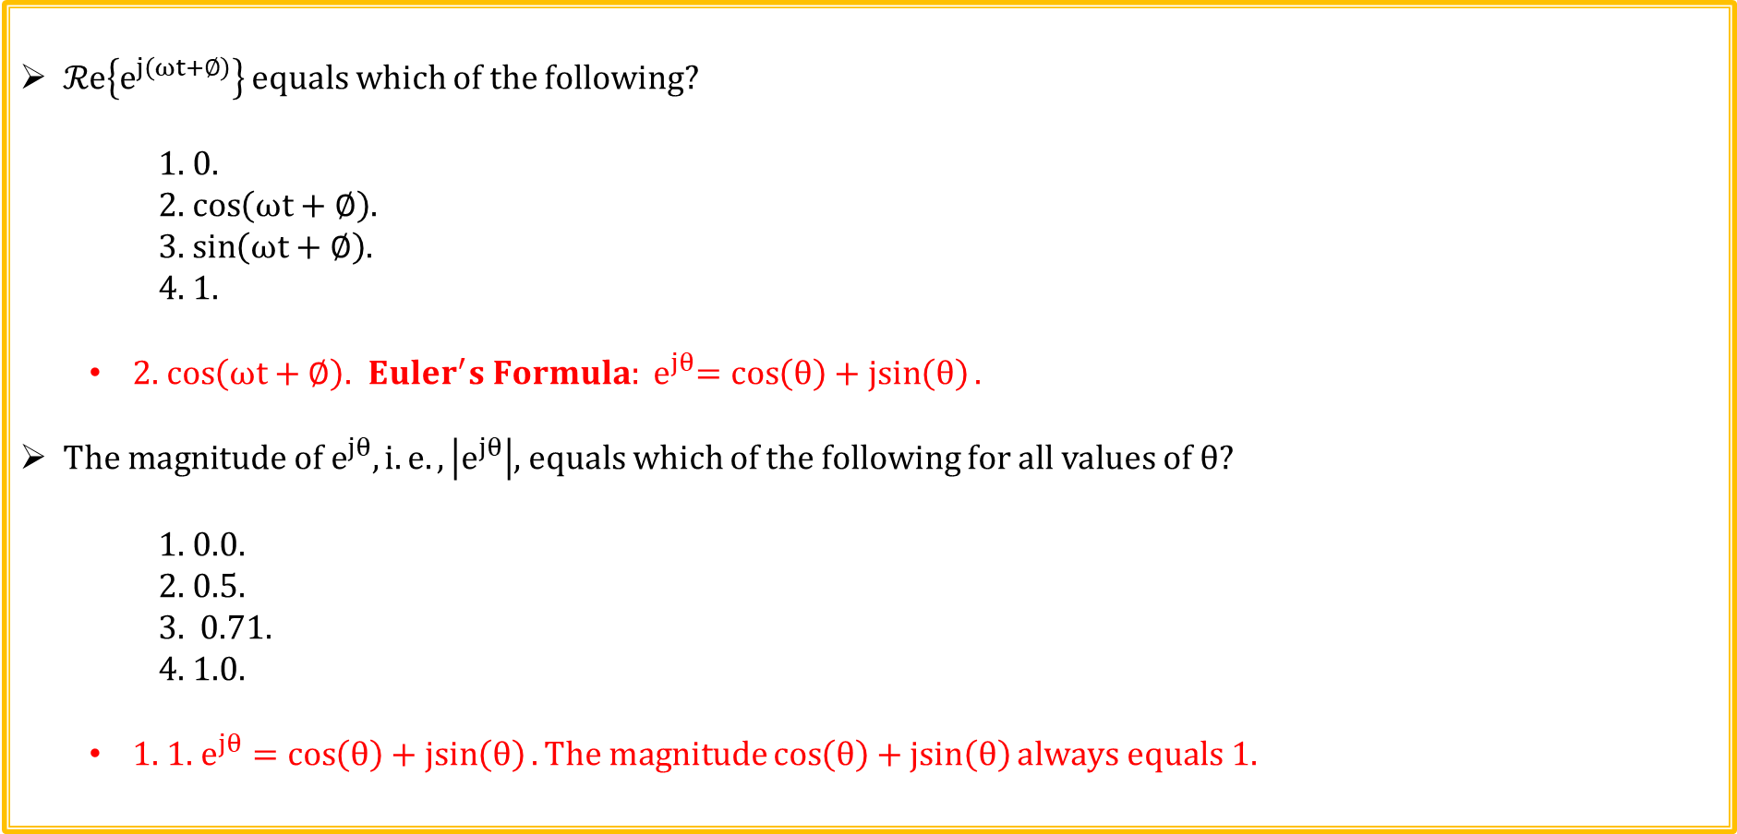
Phasors and Impedance Review Quiz 2 of 6
$ℛe\left\{e^{j\left(ωt+∅\right)}\right\}$ equals which of the following?
1. 0.
2. $\cos\left(ωt+∅\right)$.
3. $\sin\left(ωt+∅\right)$.
4. 1.
2. $\cos\left(ωt+∅\right)$.${ {Euler}^{′}s Formula: e}^{jθ}=\cos\left(θ\right)+\operatorname{jsin}\left(θ\right).$
$The magnitude of e^{jθ}, i.e., \left|e^{jθ}\right|$, equals which of the following for all values of $θ$?
1. 0.0.
2. 0.5.
3. 0.71.
4. 1.0.
1. 1. $e^{jθ}=\cos\left(θ\right)+\operatorname{jsin}\left(θ\right). The magnitude\cos\left(θ\right)+\operatorname{jsin}\left(θ\right)always equals 1.$

Slide 33

Phasors and Impedance Review Quiz 3 of 6
Choose the best answer below regarding impedance.
1. Impedance is the ratio of phasor voltage to phasor current.
2. The magnitude of impedance represents the opposition to current flow in a circuit for sinusoidal excitation.
3. Impedance is a complex number, but is not a phasor.
4. All of the above
4. All of the above$.$
The magnitude of the impedance of an inductor approaches which of the following for frequency → ∞?
1. 0.
2. 1/2πf.
3. 90˚.
4. ∞.
4. ∞$.$ X_{L} = 2πfL.

Slide 34

Phasors and Impedance Review Quiz 4 of 6
Choose the best answer below regarding admittance.
1. Admittance is the ratio of phasor voltage to phasor current.
2. The magnitude of admittance represent the opposition to current flow in a circuit for sinusoidal excitation.
3. Admittance is the reciprocal of impedance.
4. All of the above
3. Admittance is the reciprocal of impedance and has units of siemens (S).
The magnitude of the impedance of a capacitor approaches which of the following for frequency → ∞?
1. 0.
2. 1/2πf.
3. 90˚.
4. ∞.
1. 0$.$ X_{C} = 1/(2πfC).

Slide 35

Phasors and Impedance Review Quiz 5 of 6
Choose the best answer below regarding capacitor impedance.
1. $Z_{C}=X_{C} ∠\left(−90˚\right).$
2. $Z_{C}=1/{X_{C} }∠\left(−90˚\right).$
3. $Z_{C}=X_{C} ∠\left(90˚\right)$.
4. $Z_{C}=1/{X_{C} }∠\left(90˚\right)$.
1. $Z_{C}=X_{C} ∠\left(−90˚\right)=−jX_{C}, with X_{C}=1/{ωC}=1/{2πfC}.$
Choose the best answer below regarding inductor impedance.
1. $Z_{L}=X_{L} ∠\left(−90˚\right).$
2. $Z_{L}=1/{X_{L} }∠\left(−90˚\right).$
3. $Z_{L}=X_{L} ∠\left(90˚\right)$.
4. $Z_{L}=1/{X_{L} }∠\left(90˚\right)$.
3. $Z_{L}=X_{L} ∠\left(90˚\right)=jX_{L}, with X_{L}=ωL=2πfL.$

Slide 36

Phasors and Impedance Review Quiz 6 of 6
Choose the best answer below regarding capacitor admittance.
1. $Y_{C}=\left(1/{2πfC}\right)∠\left(−90˚\right).$
2. $Y_{C}=\left(2πfC\right)∠\left(−90˚\right).$
3. $Y_{C}=\left(1/{2πfC}\right)∠\left(90˚\right)$.
4. $Y_{C}=\left(2πfC\right)∠\left(90˚\right)$.
$\text{4}\text{. }Y_{C}=1/{Z_{C}}=jωC=\left(2πfC\right)∠\left(90˚\right).$
Choose the best answer below regarding why impedance, rather than just resistance, is employed for circuits involving inductors and capacitors.
1. Voltage and current can be out of phase, resulting in instantaneous
resistance values ranging between ± ∞$.$
2. The opposition to current flow, i.e. reactance, of inductors and capacitors is a function of frequency.
3. Ohm’s law, KVL and KCL apply to ac steady state circuits when using phasors and impedance.
4. All of the above.
4. All of the above$.$

Slide 37
Extra

